Slide 1


Slide 2
OUR
COMPLETED
PROJECTS

Slide 3
7X THE BUSINESS HUB
OFFICES & SHOWROOMS
COLLEGE ROAD, BHOLAV
BHARUCH

Slide 4
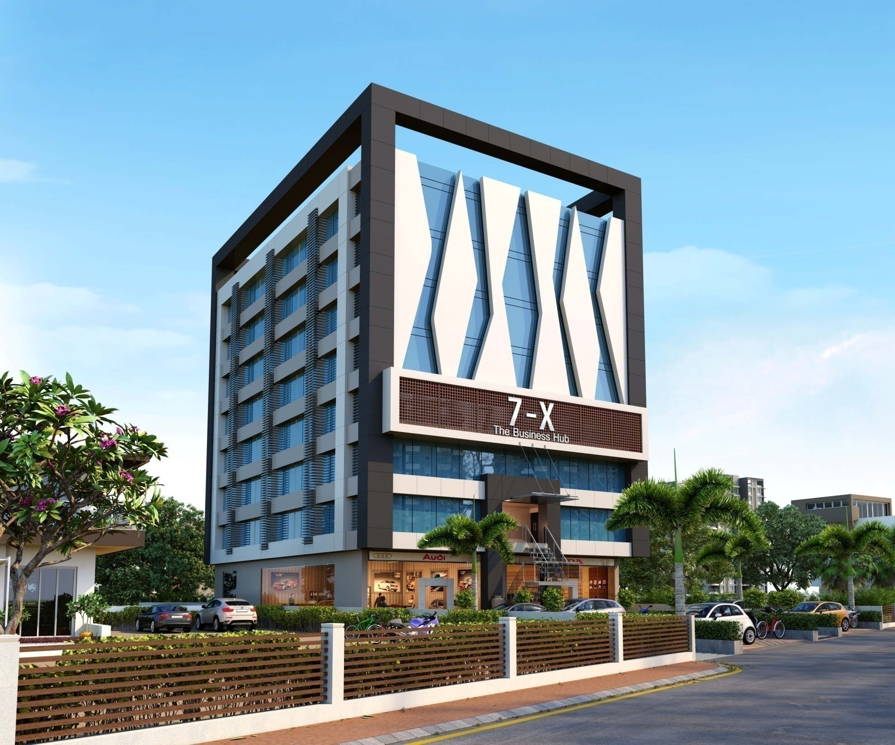

Slide 5
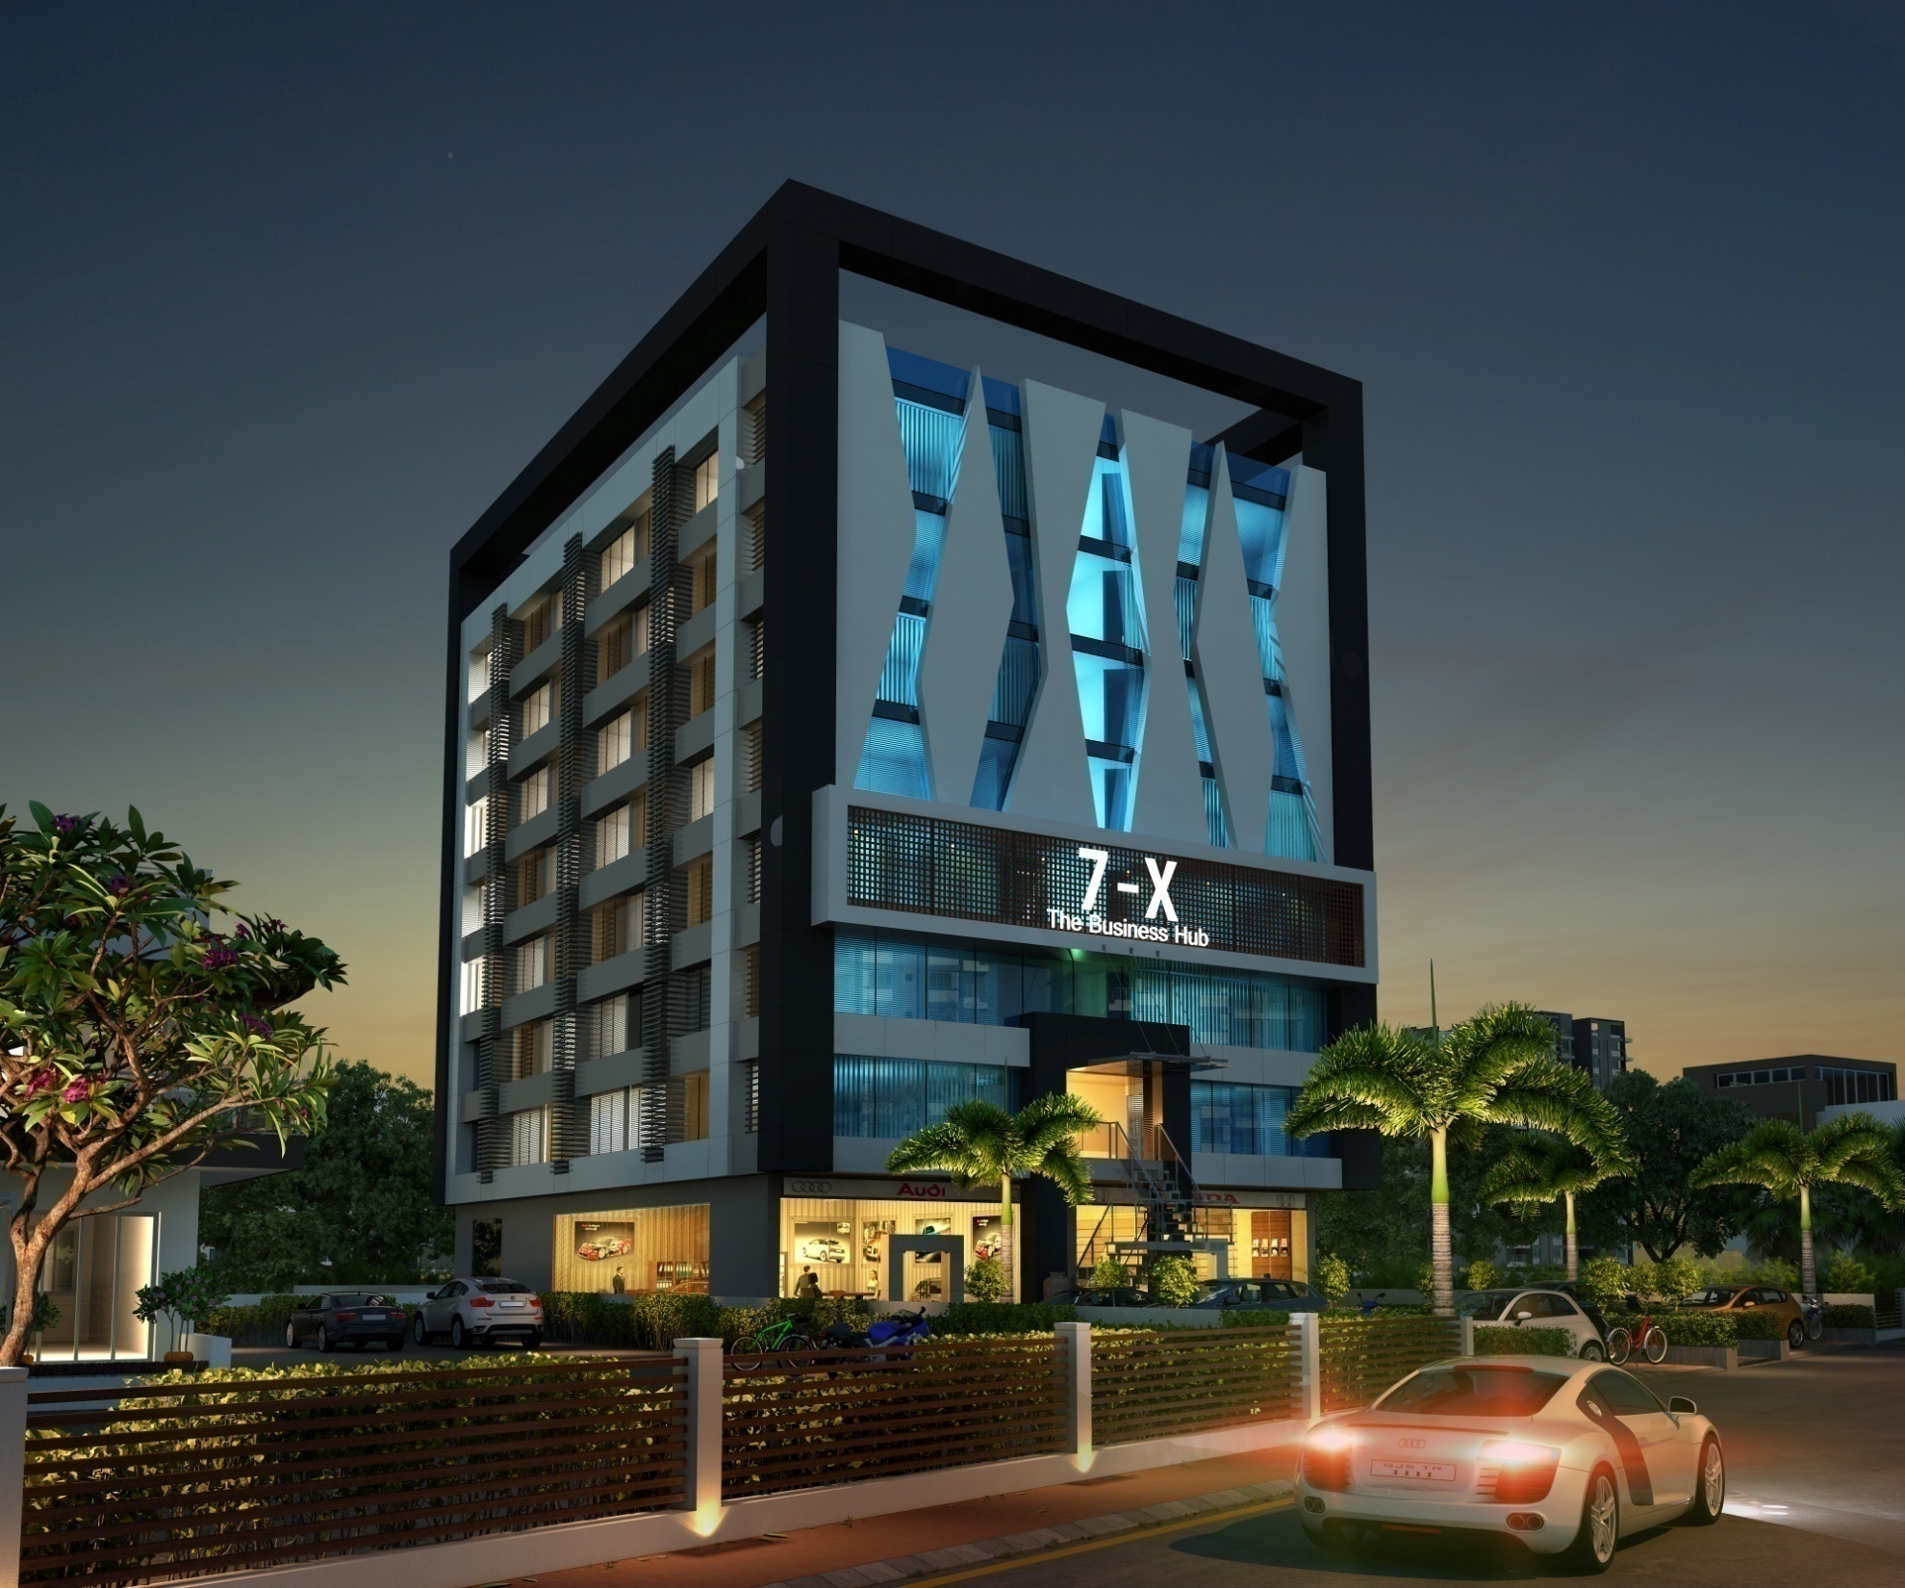

Slide 6
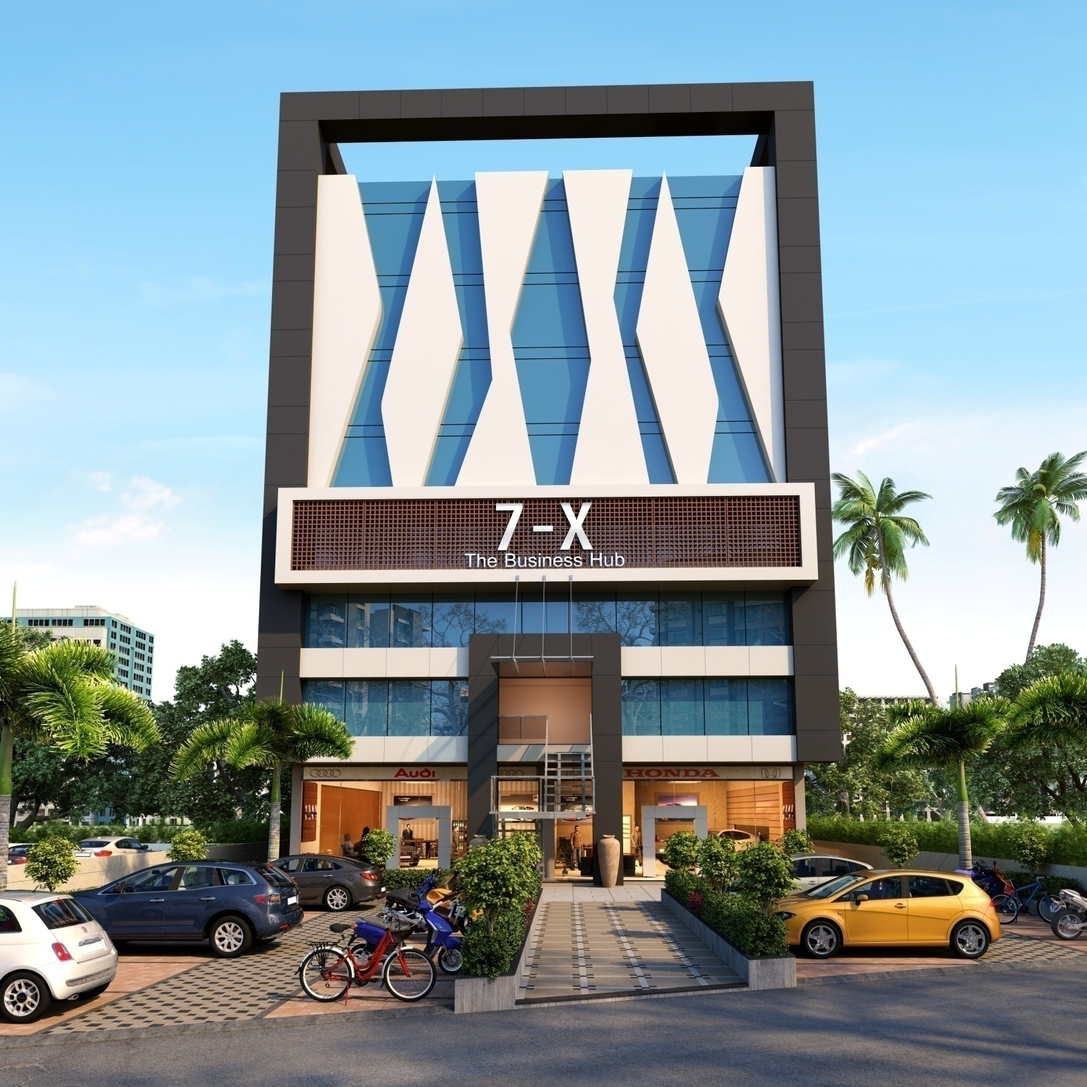

Slide 7
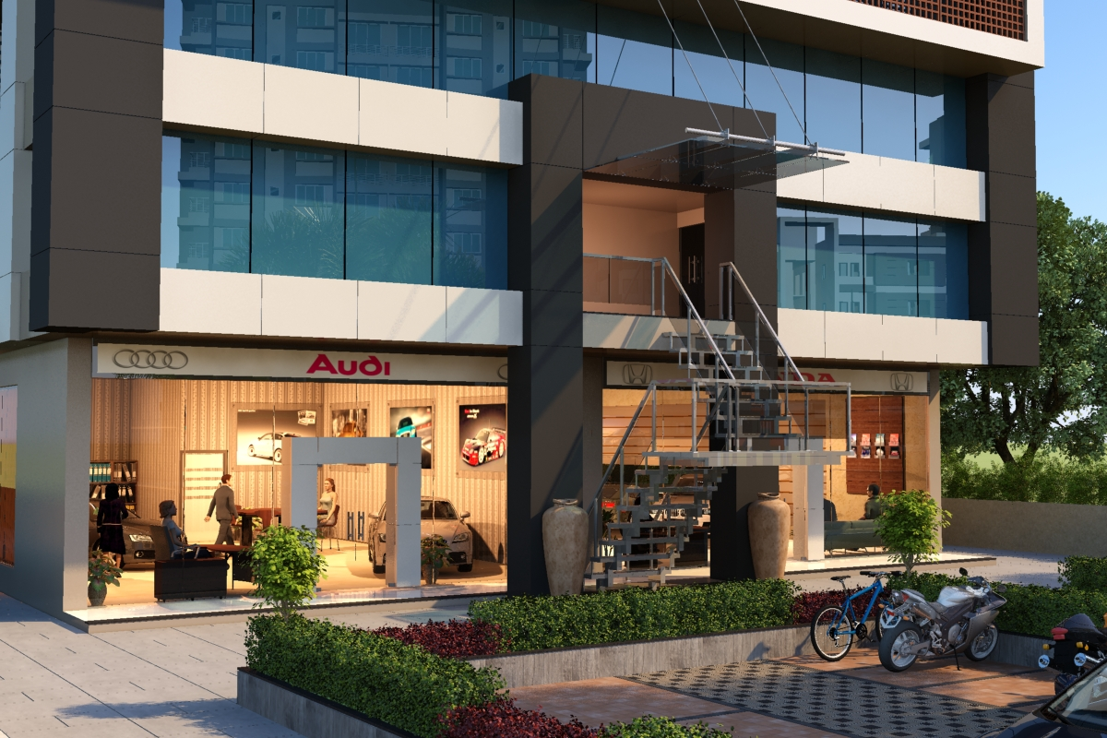

Slide 8
7X CORRIDOR
SHOPS & OFFICES
PACHBATTI
SONERI MAHAL ROAD
BHARUCH

Slide 9
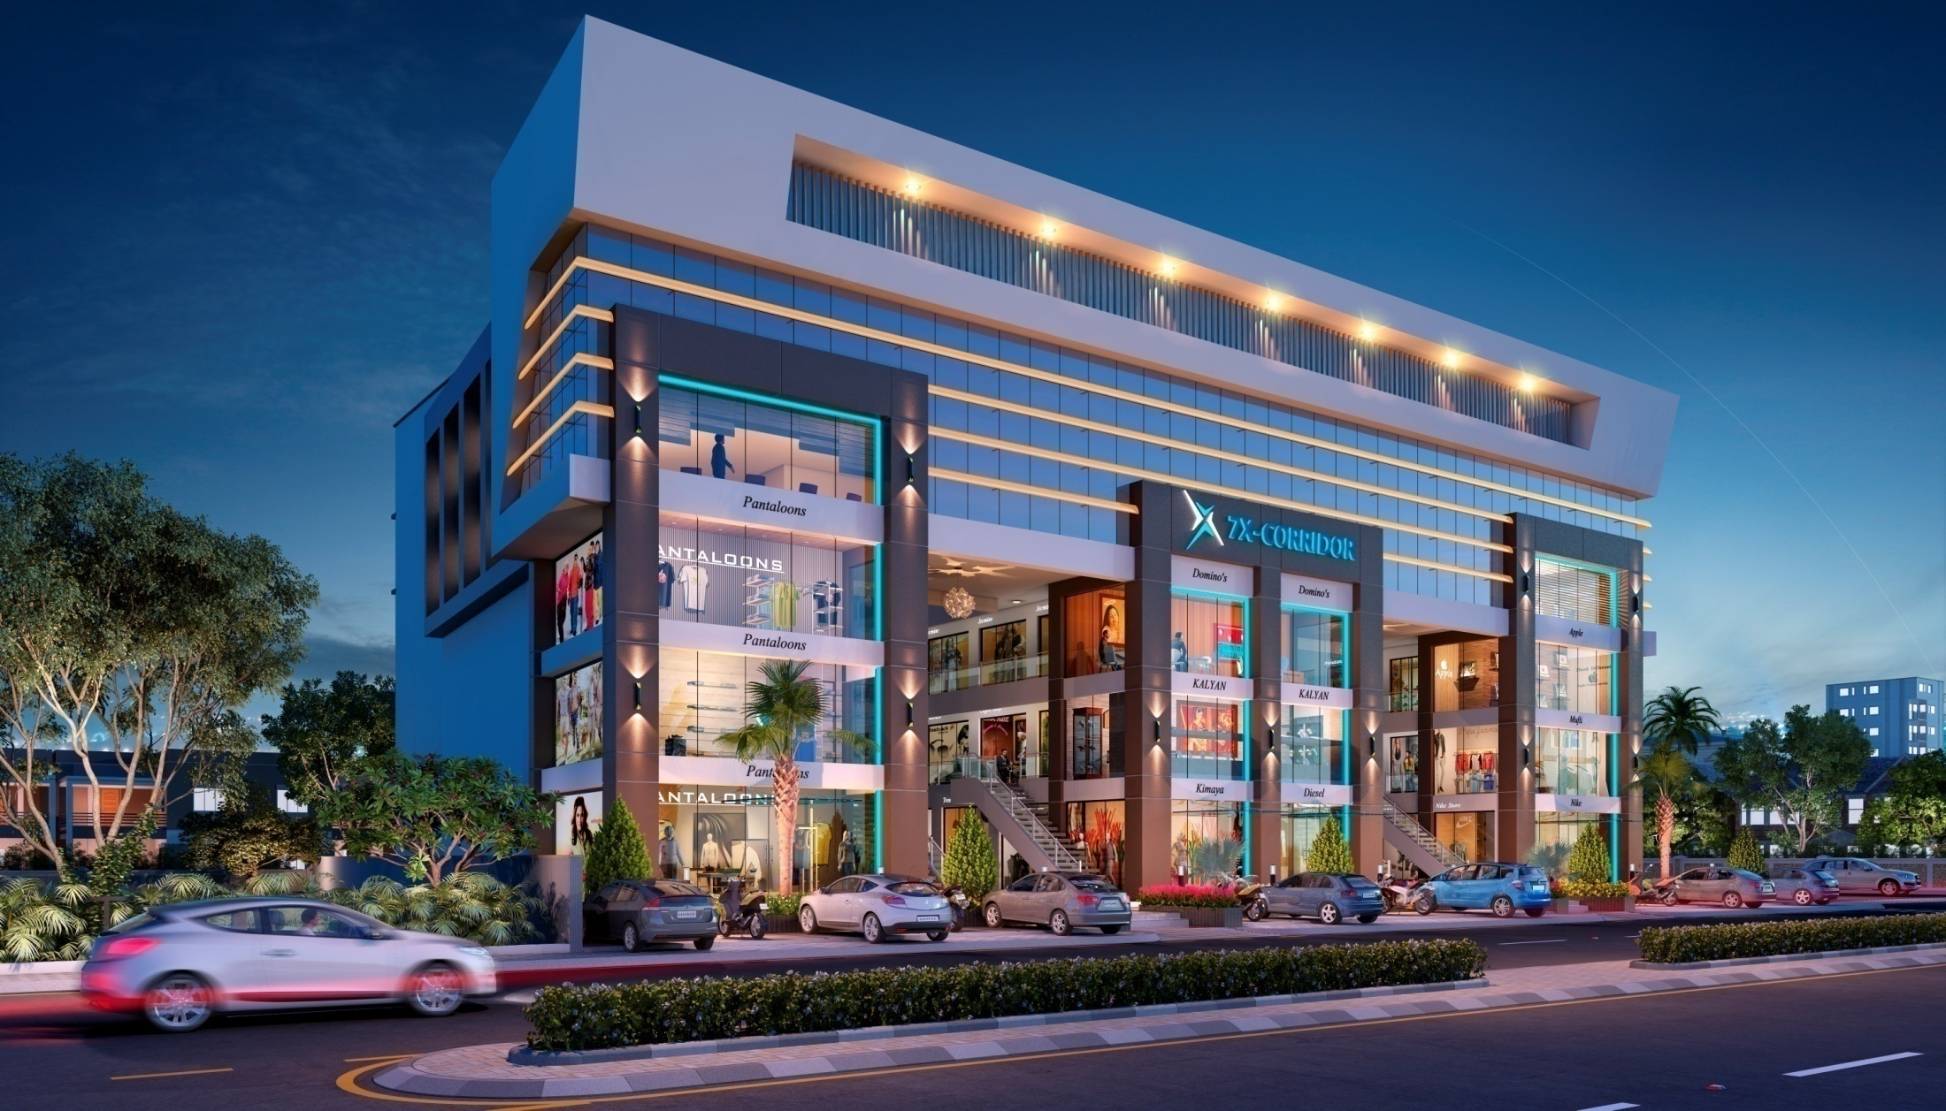

Slide 10
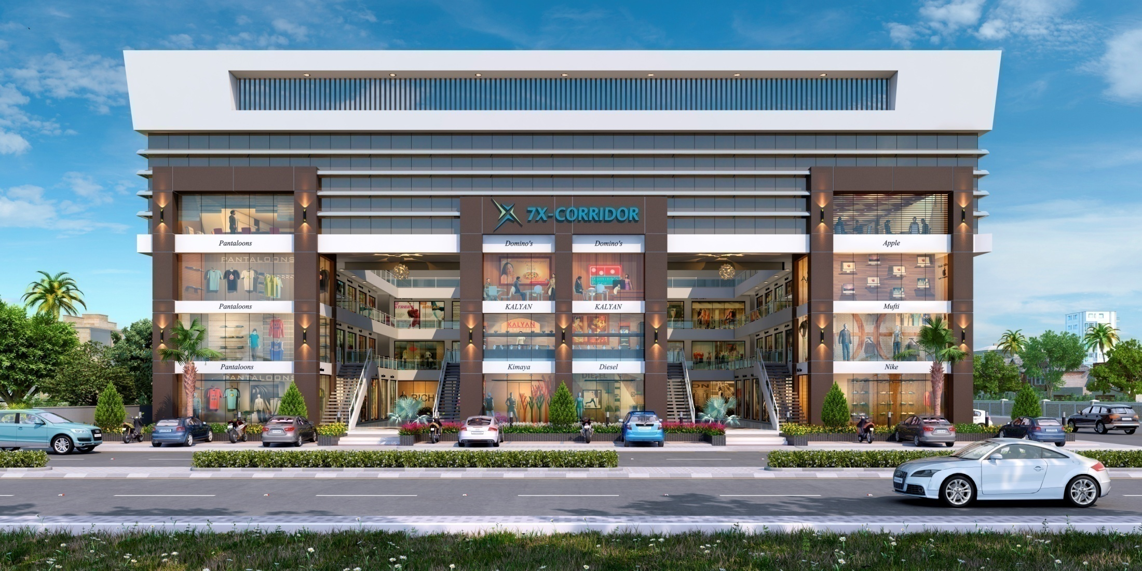

Slide 11
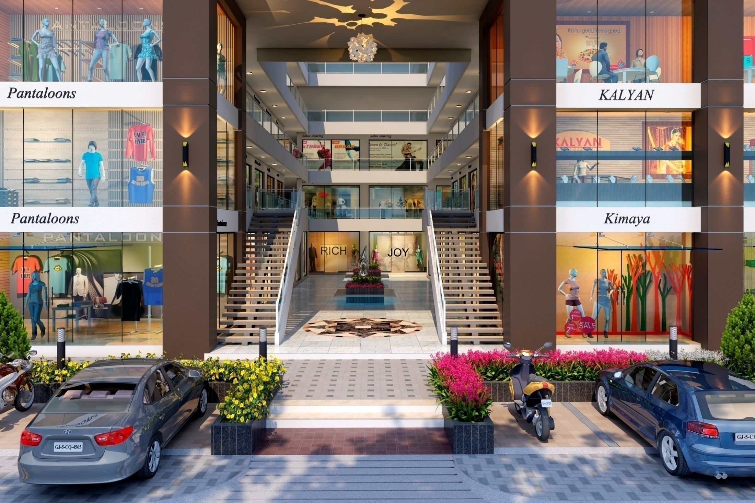

Slide 12
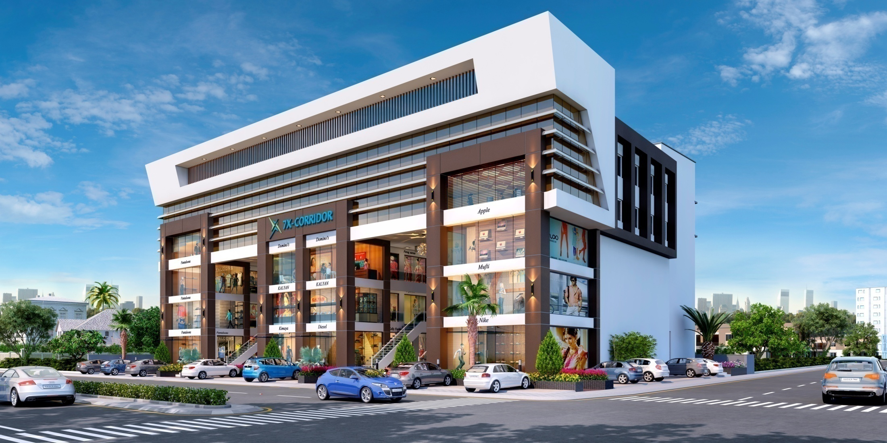

Slide 13
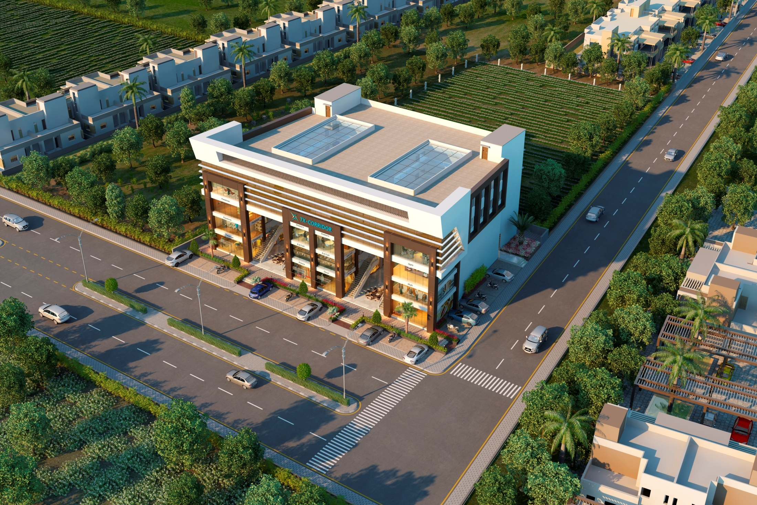

Slide 14

ASPIRE TO ACHIEVE
LEARN TO EXCEL
Near Chavaj Chowkdi, Chavaj Paguthan Road, Bharuch.

Slide 15
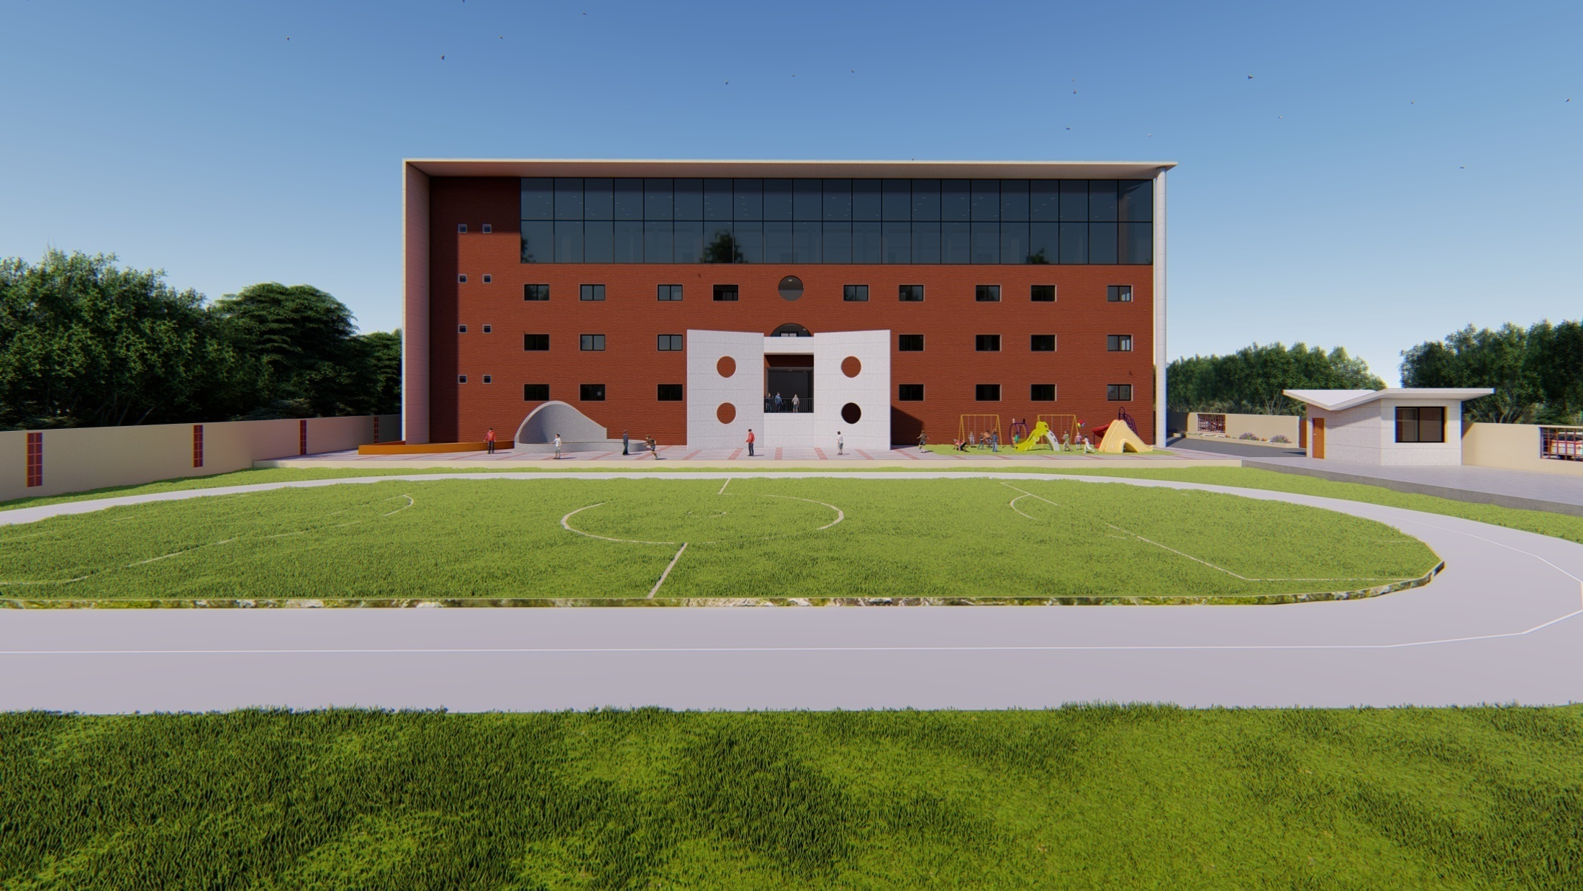

Slide 16
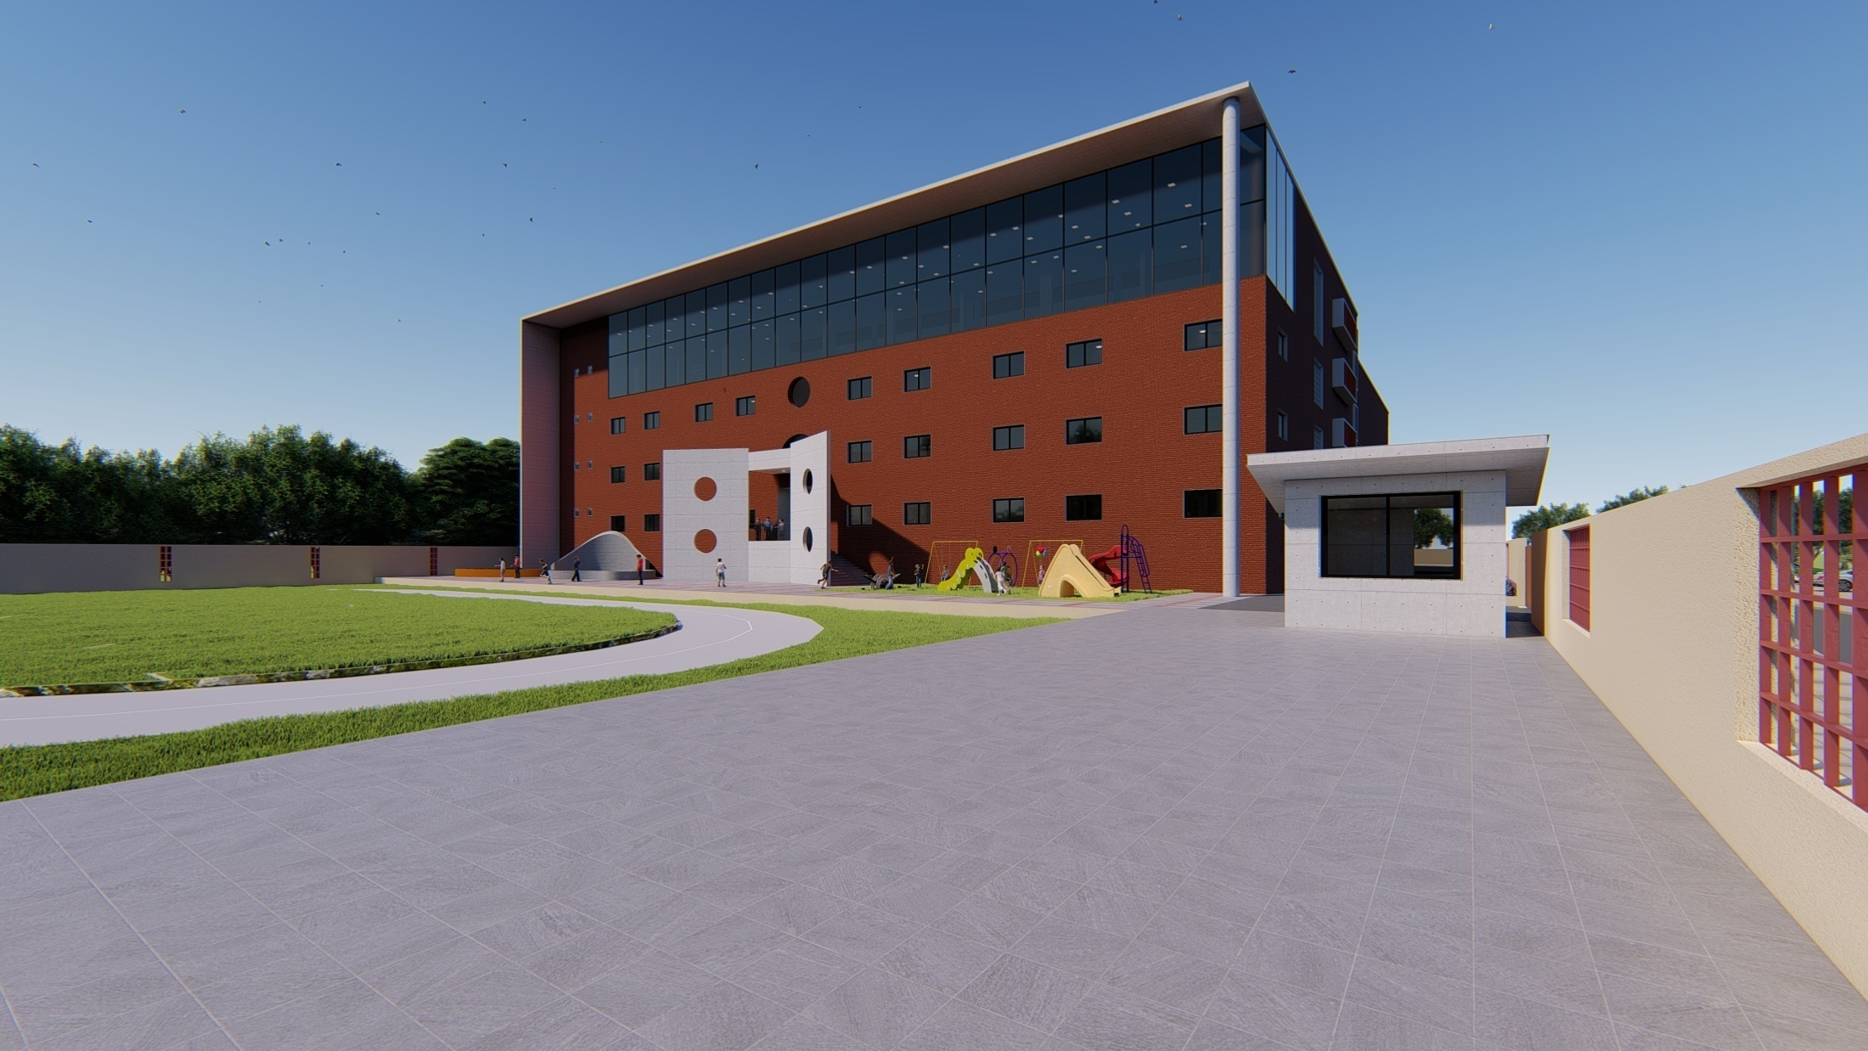

Slide 17
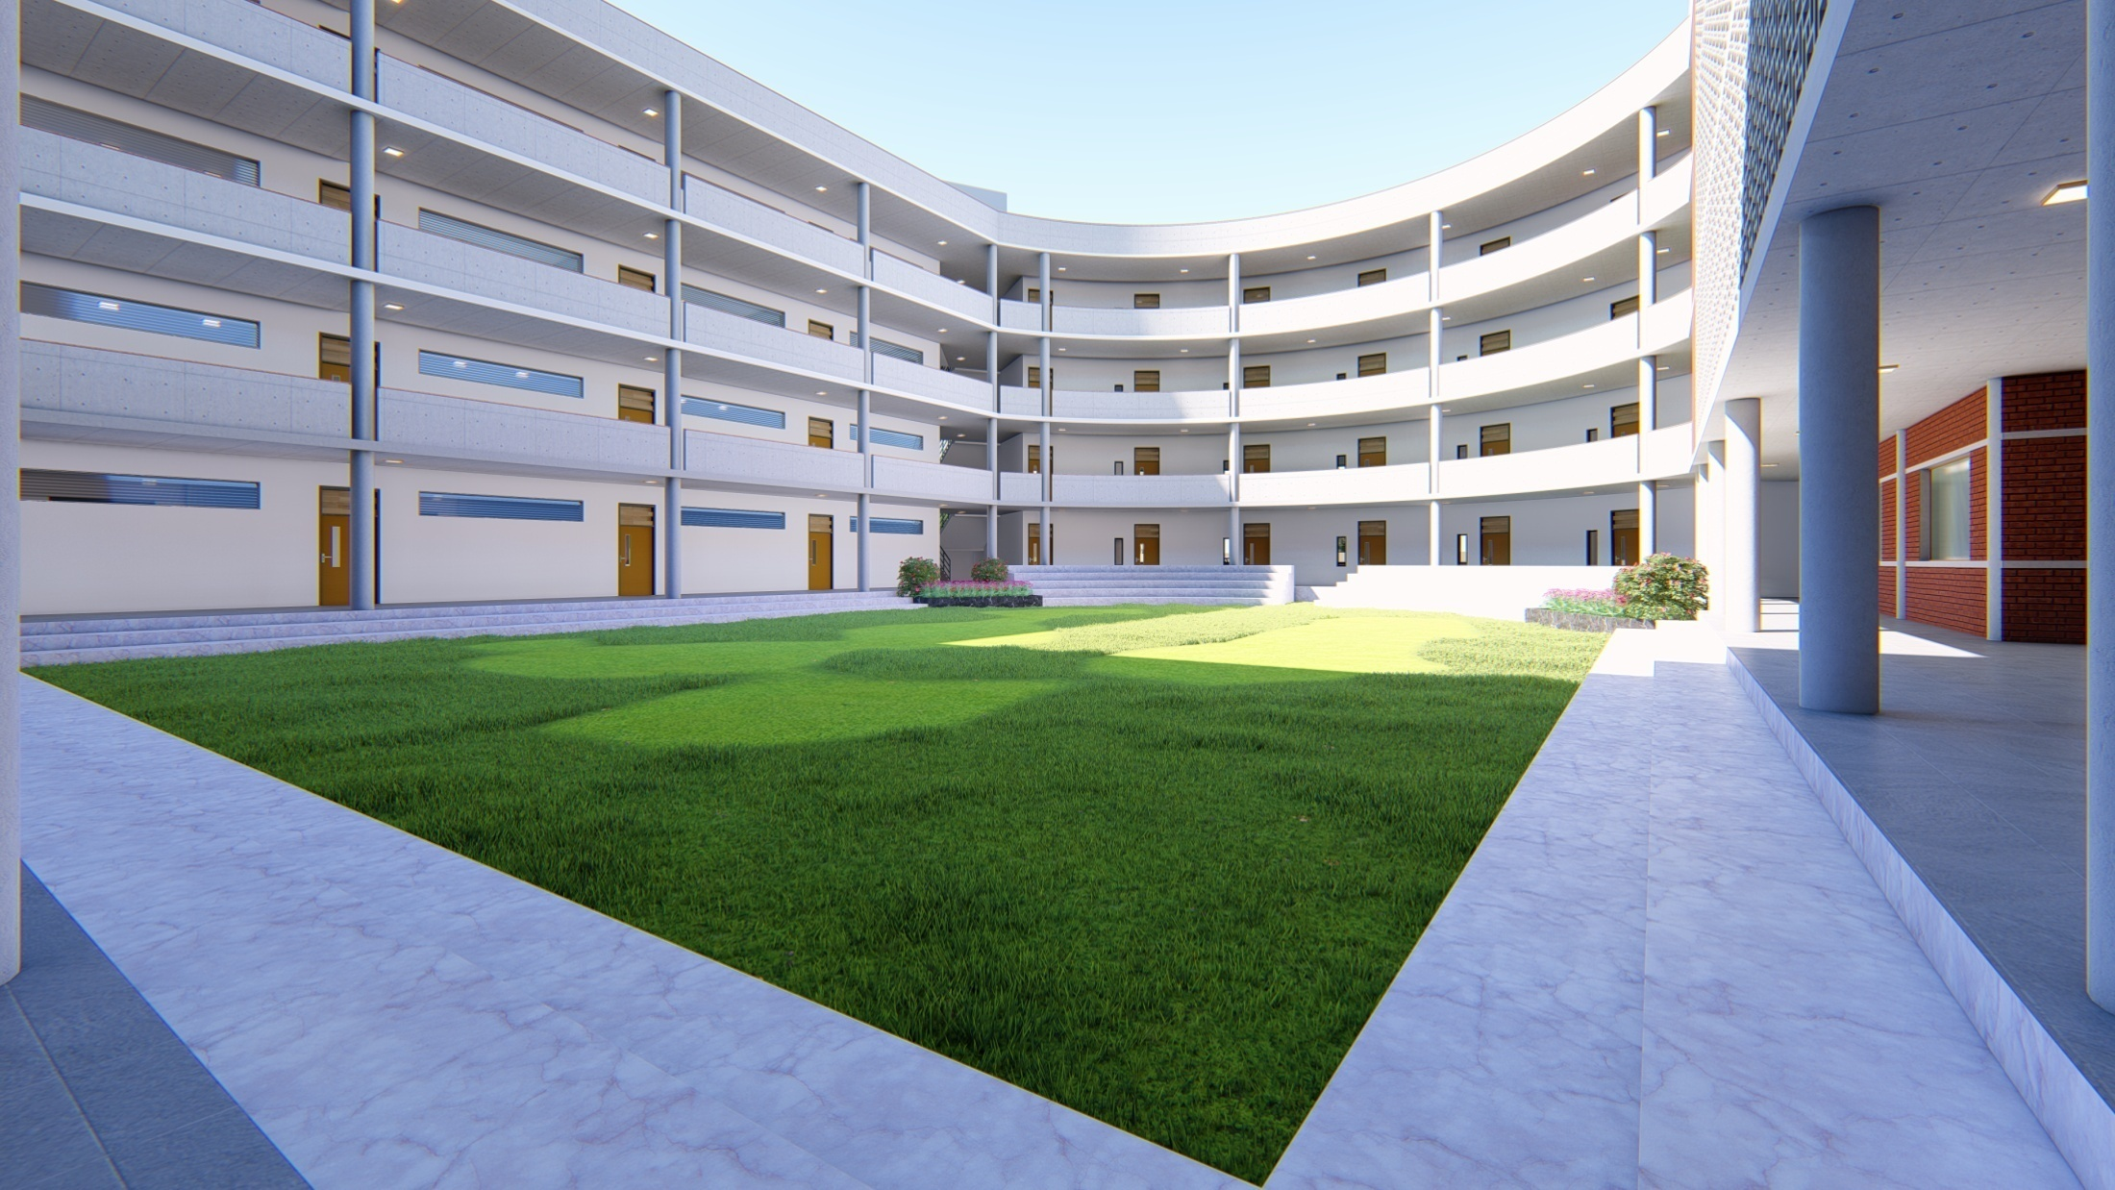

Slide 18
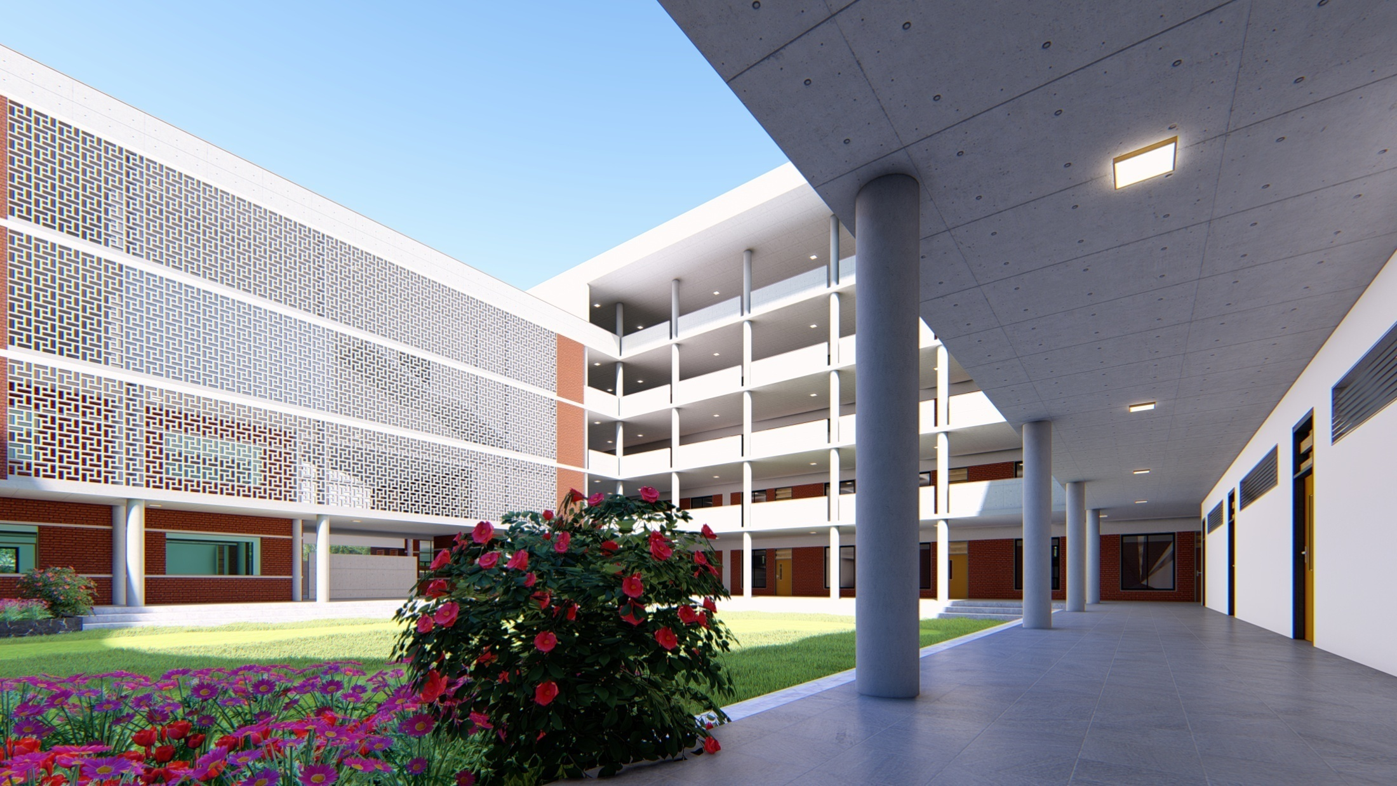

Slide 19
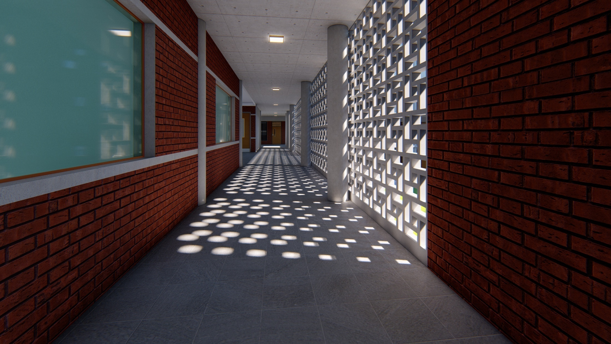

Slide 20
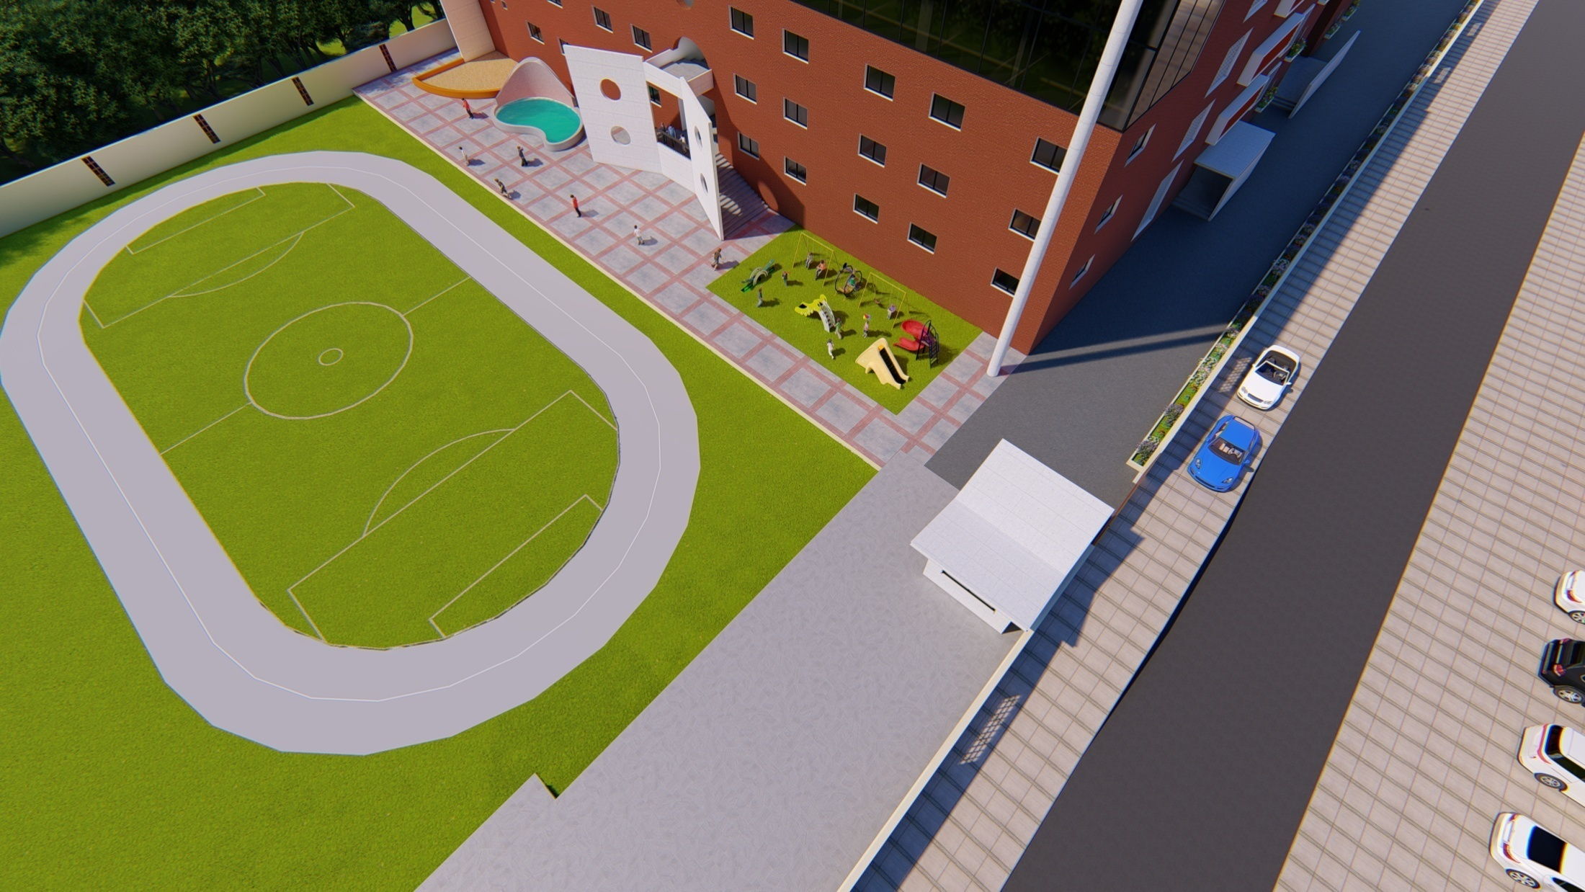

Slide 21
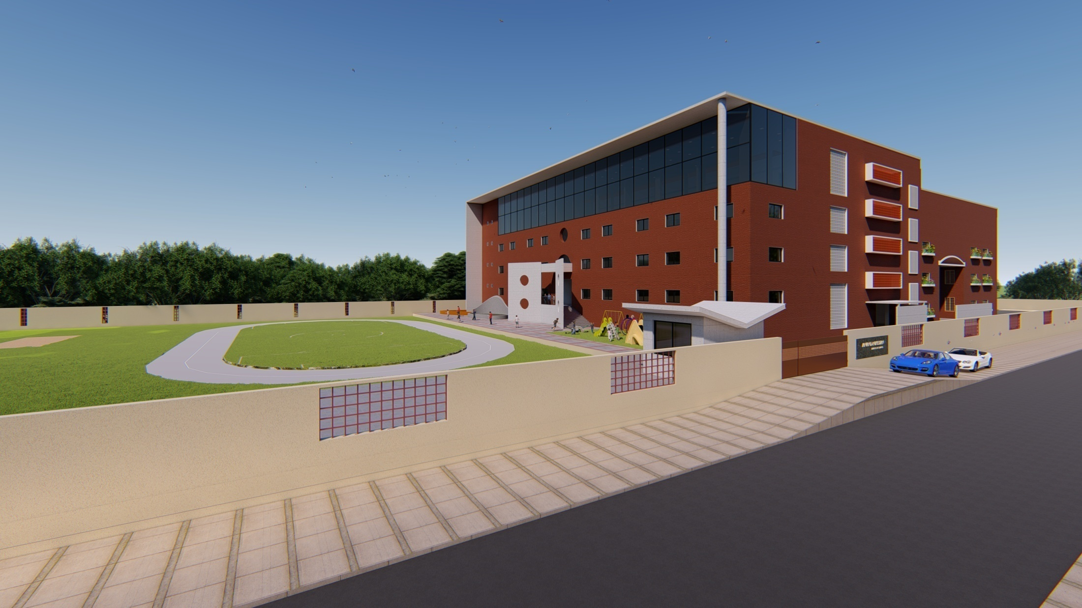

Slide 22
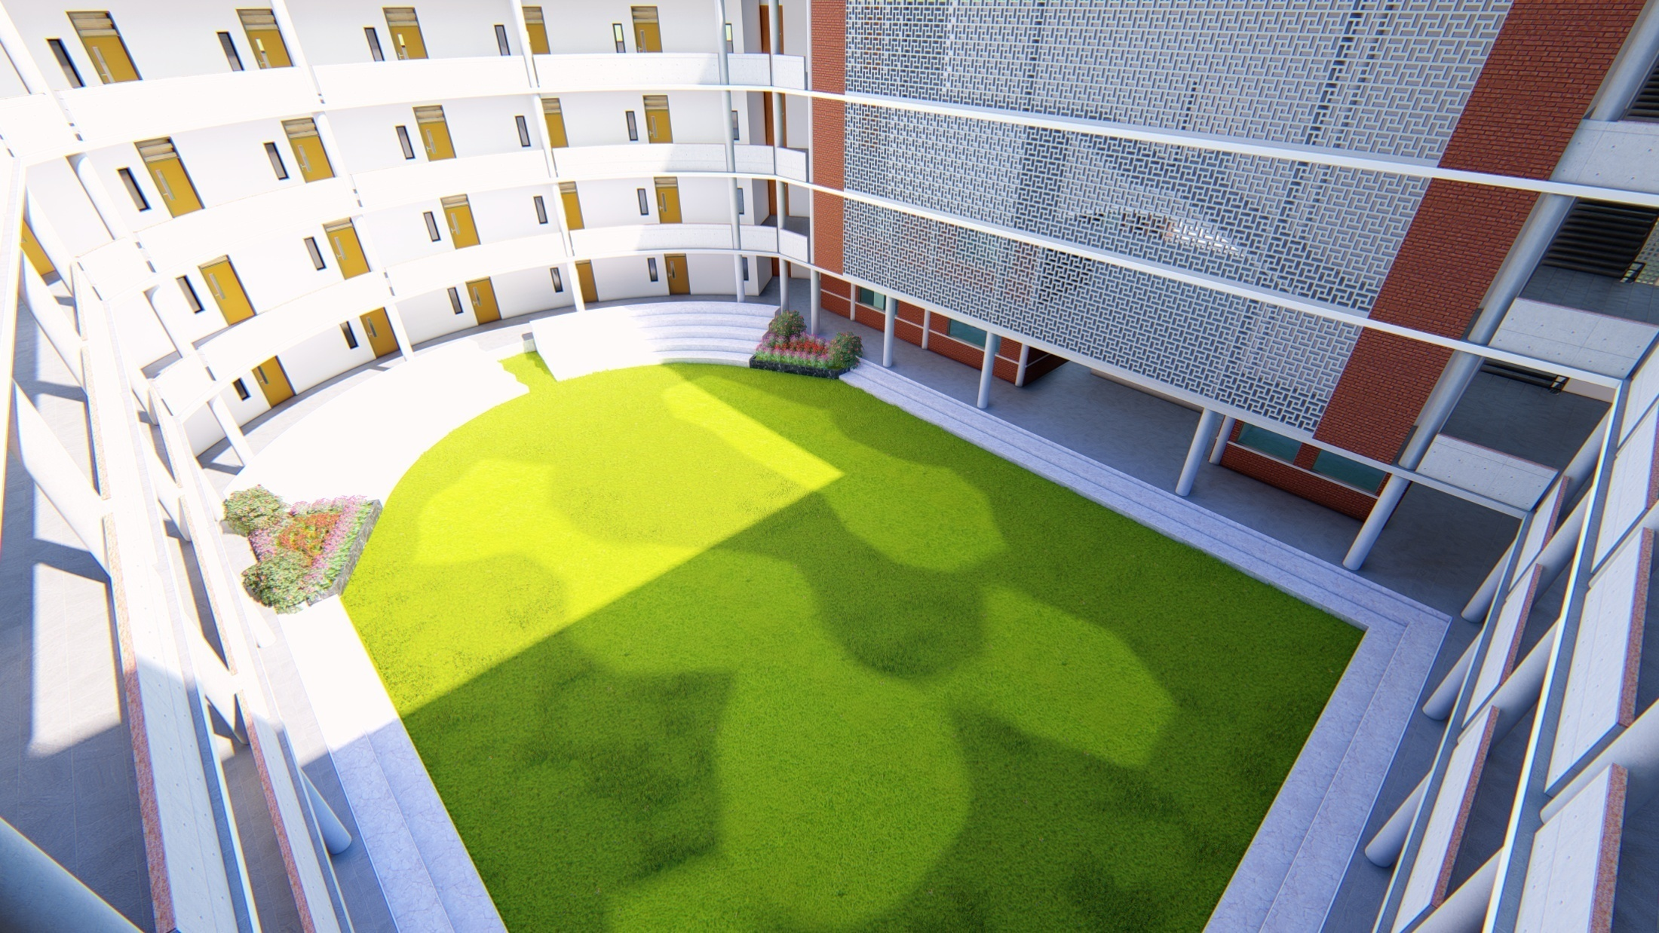

Slide 23
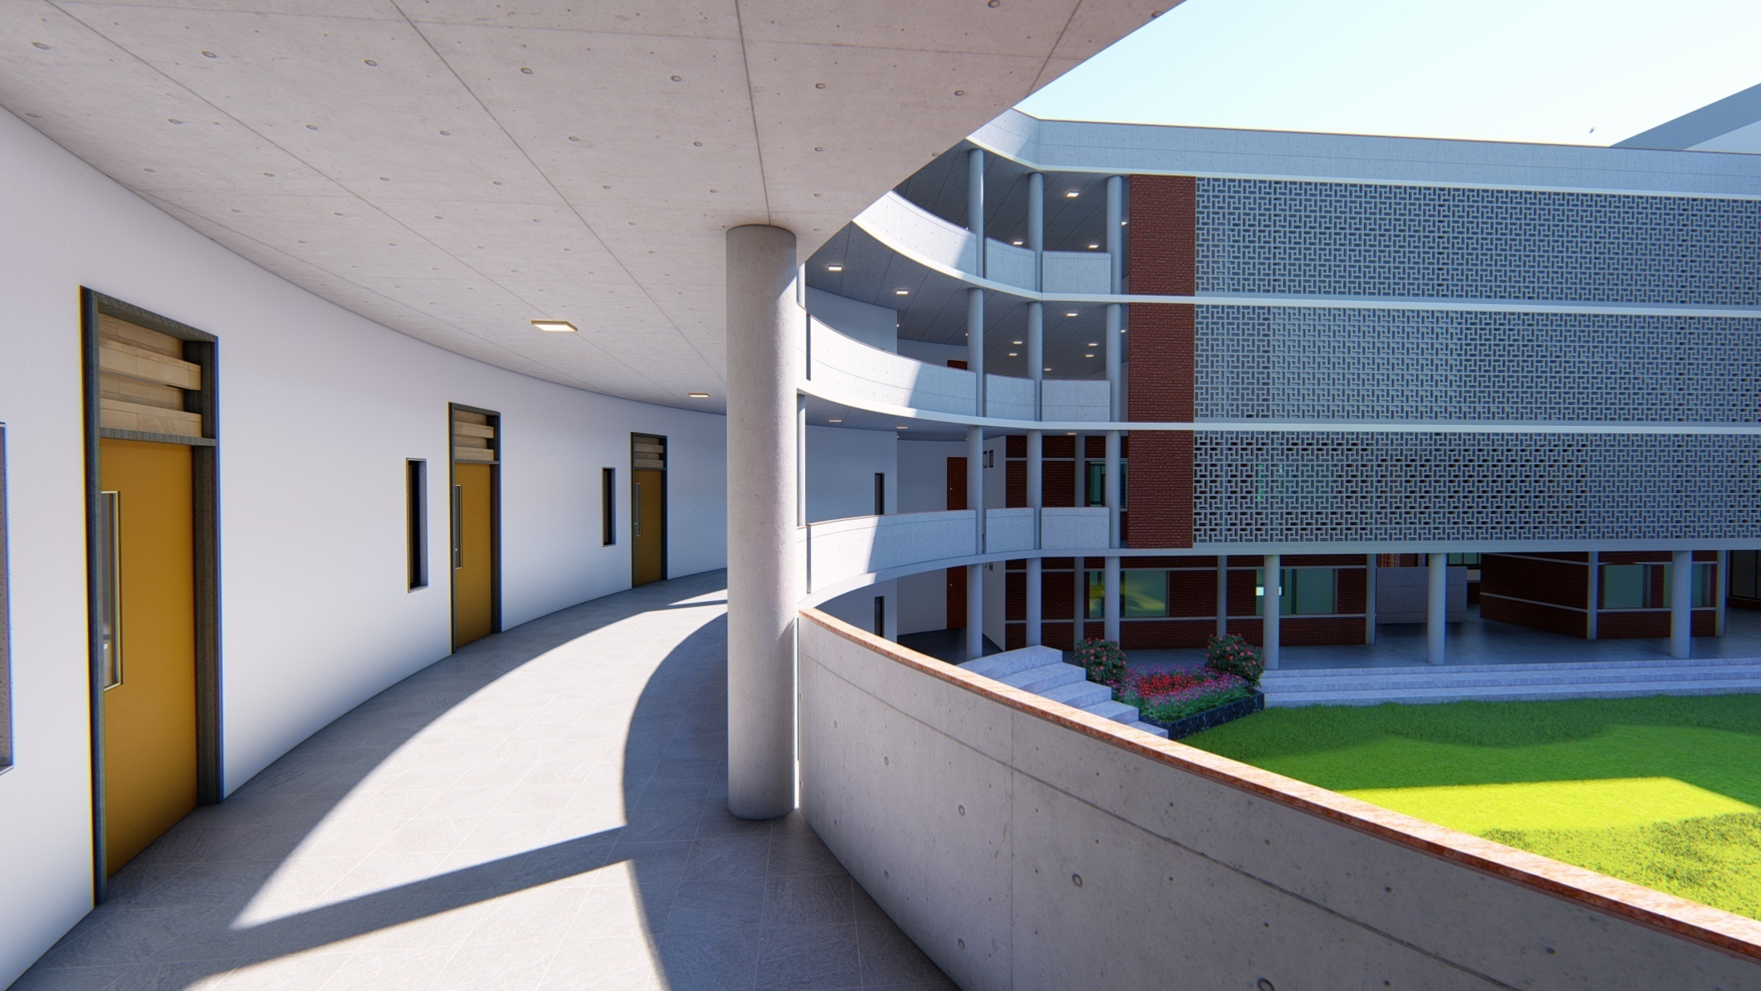

Slide 24
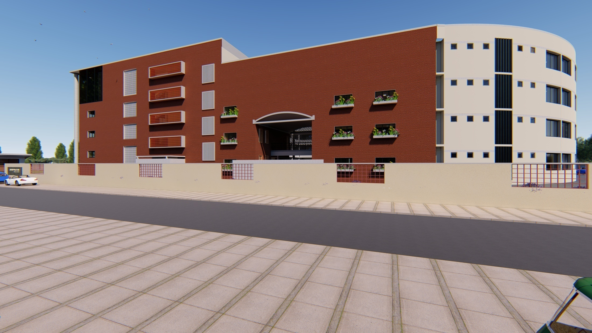

Slide 25
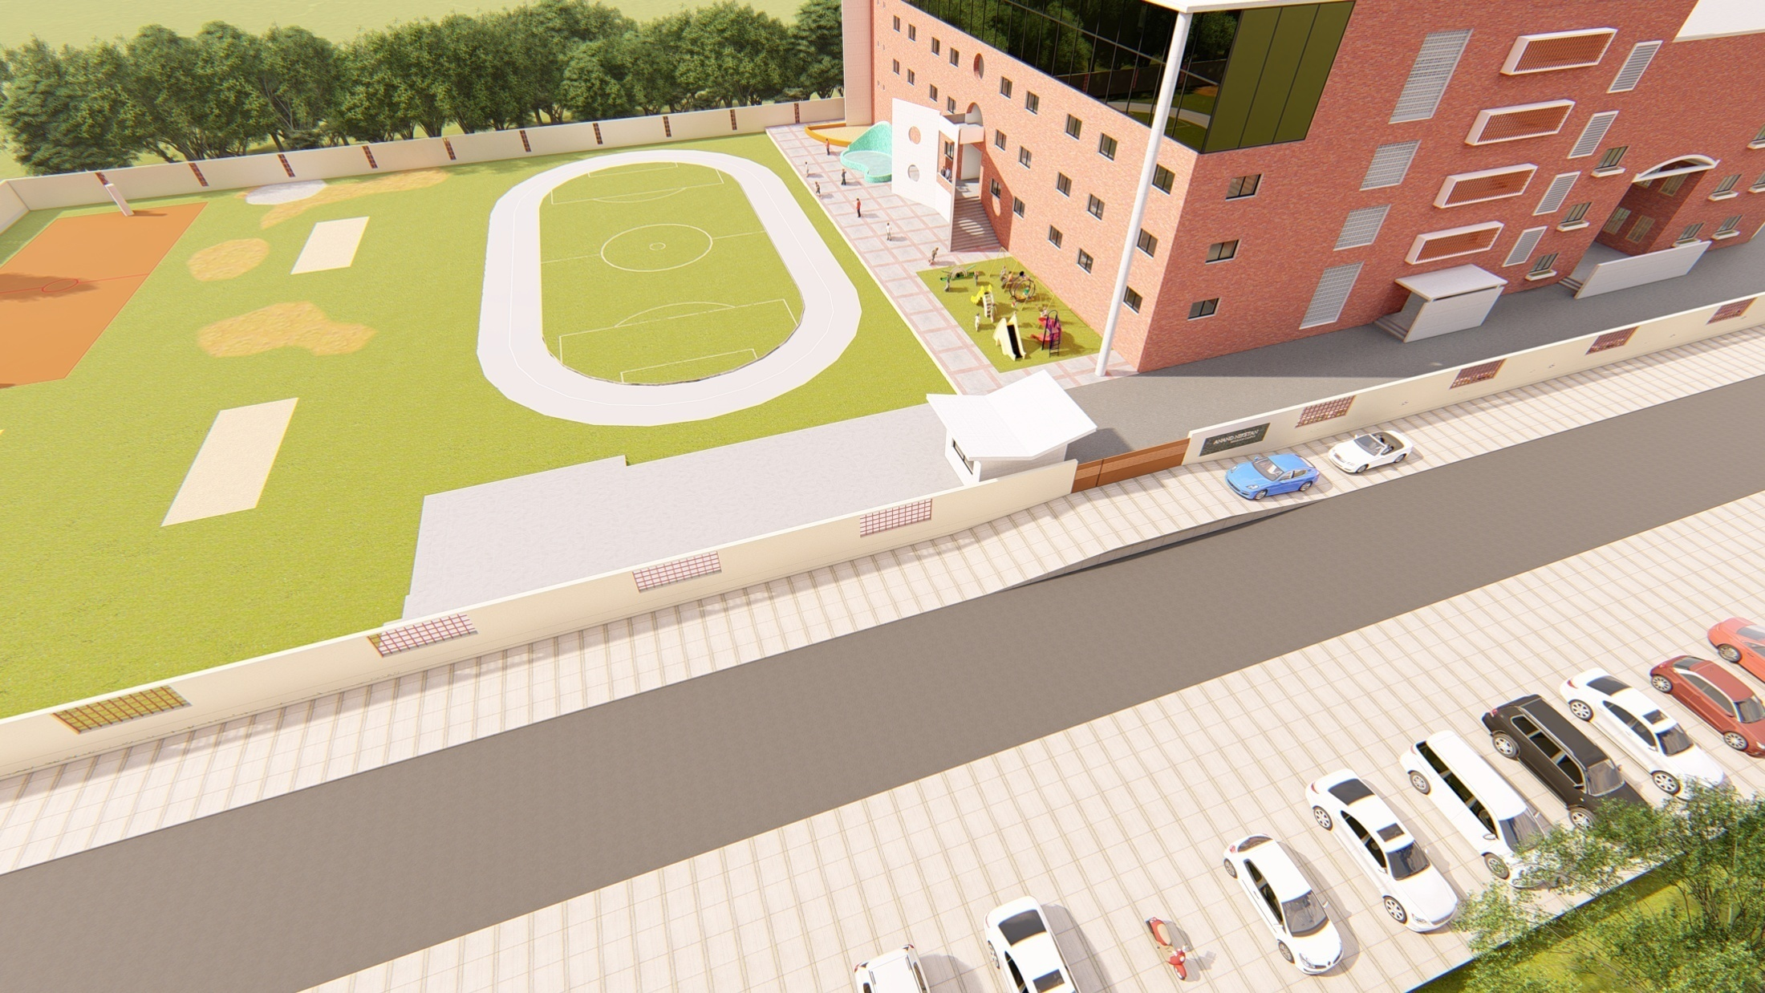

Slide 26
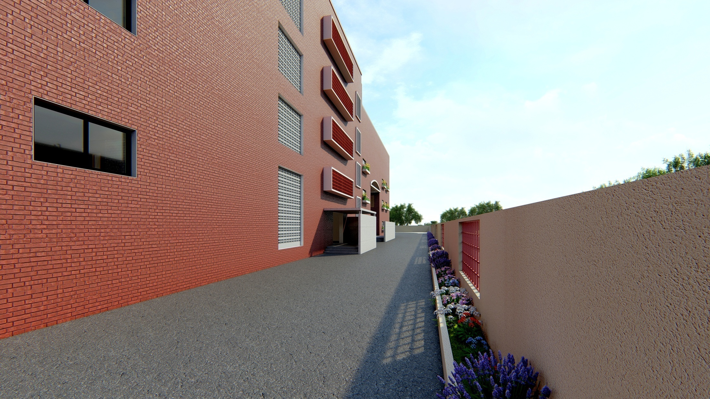

Slide 27
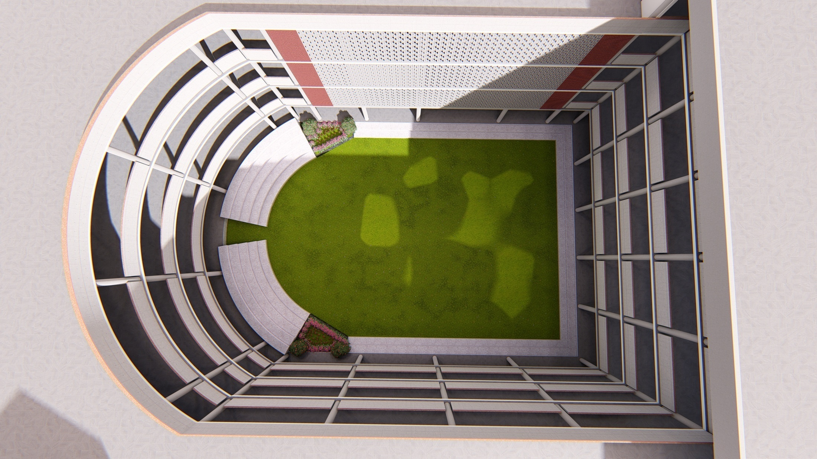

Slide 28
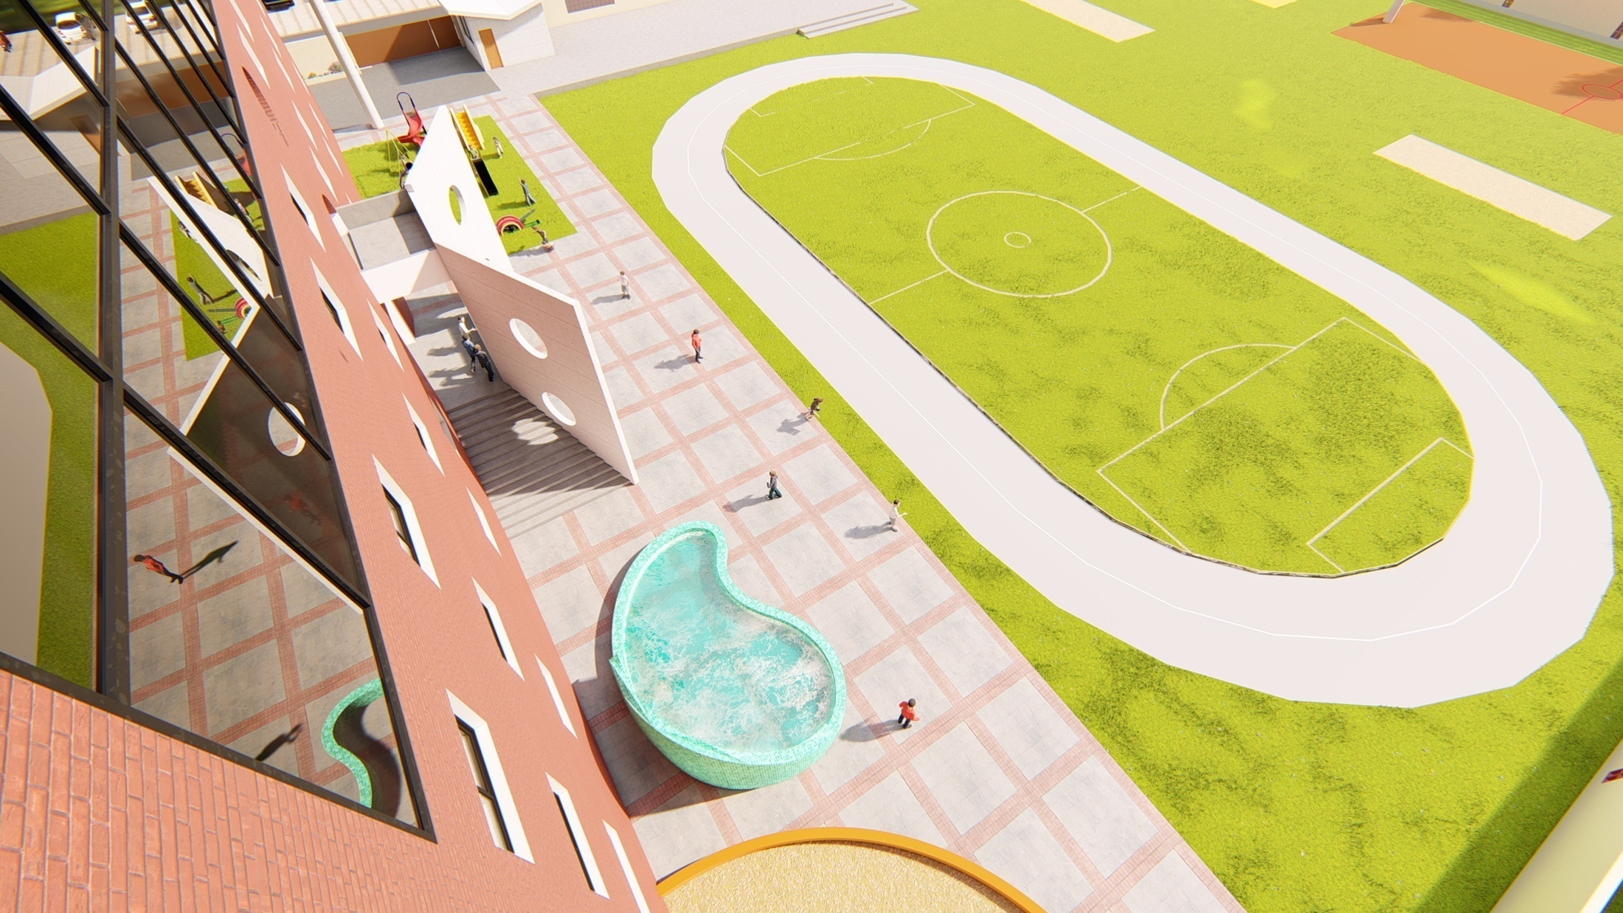

Slide 29
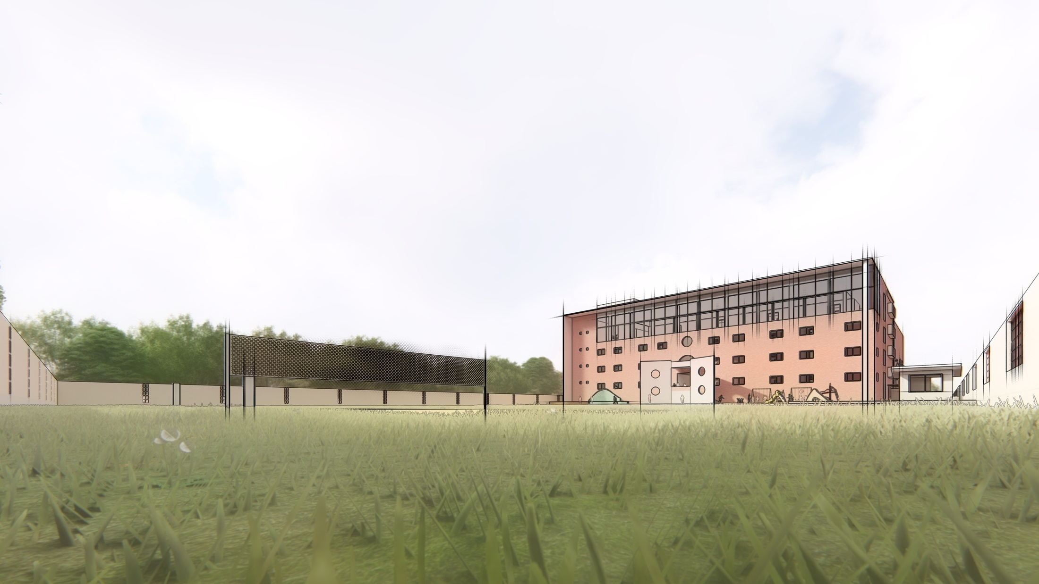

Slide 31
7 X FLORA
RESIDENCY
ZADESHWAR TAVRA ROAD
BHARUCH
MODERNATE FACILITY 1 BHK LIFESTYLE FLATS

Slide 32
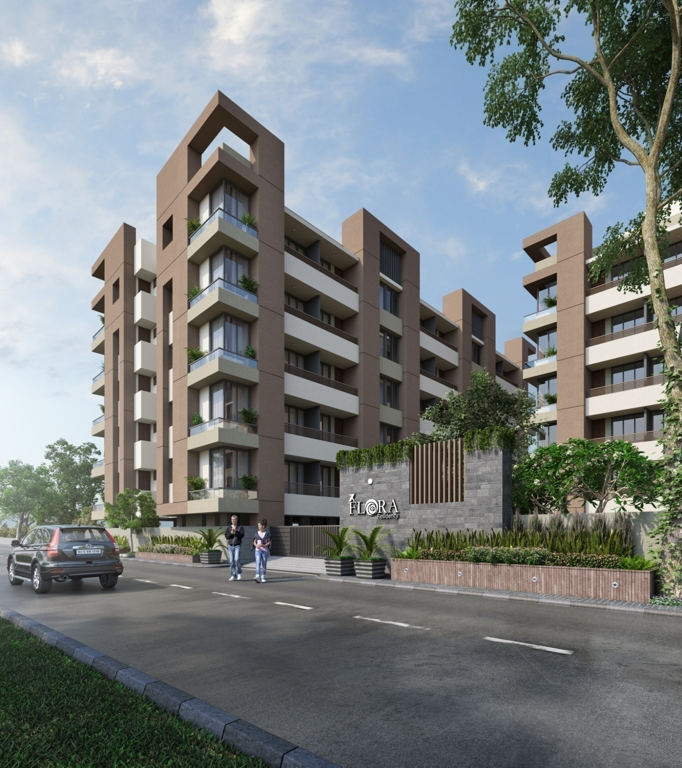

Slide 33
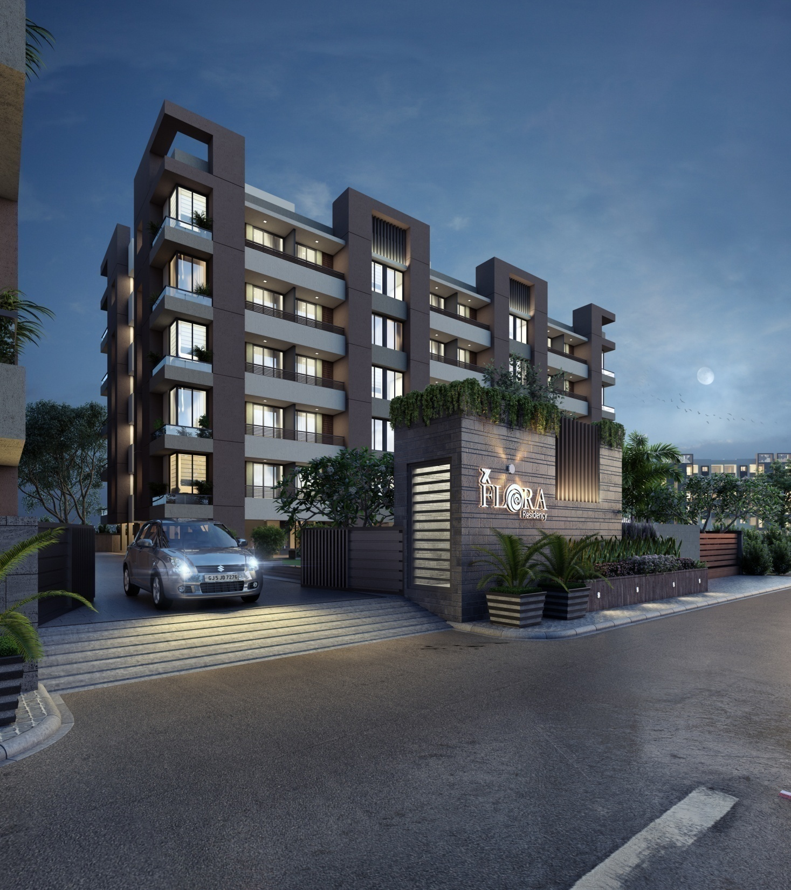

Slide 34
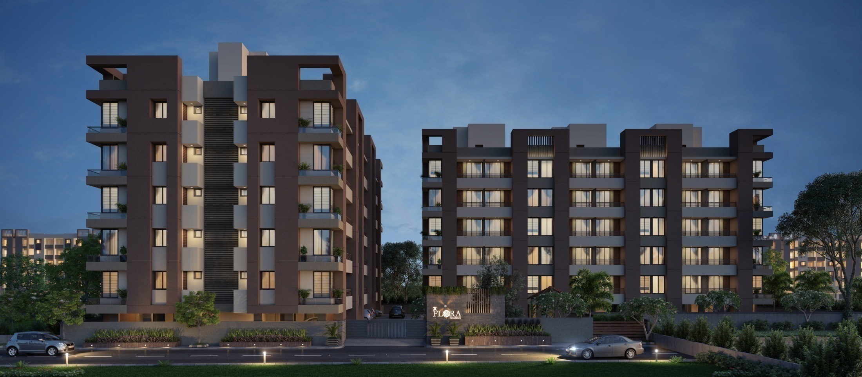

Slide 35
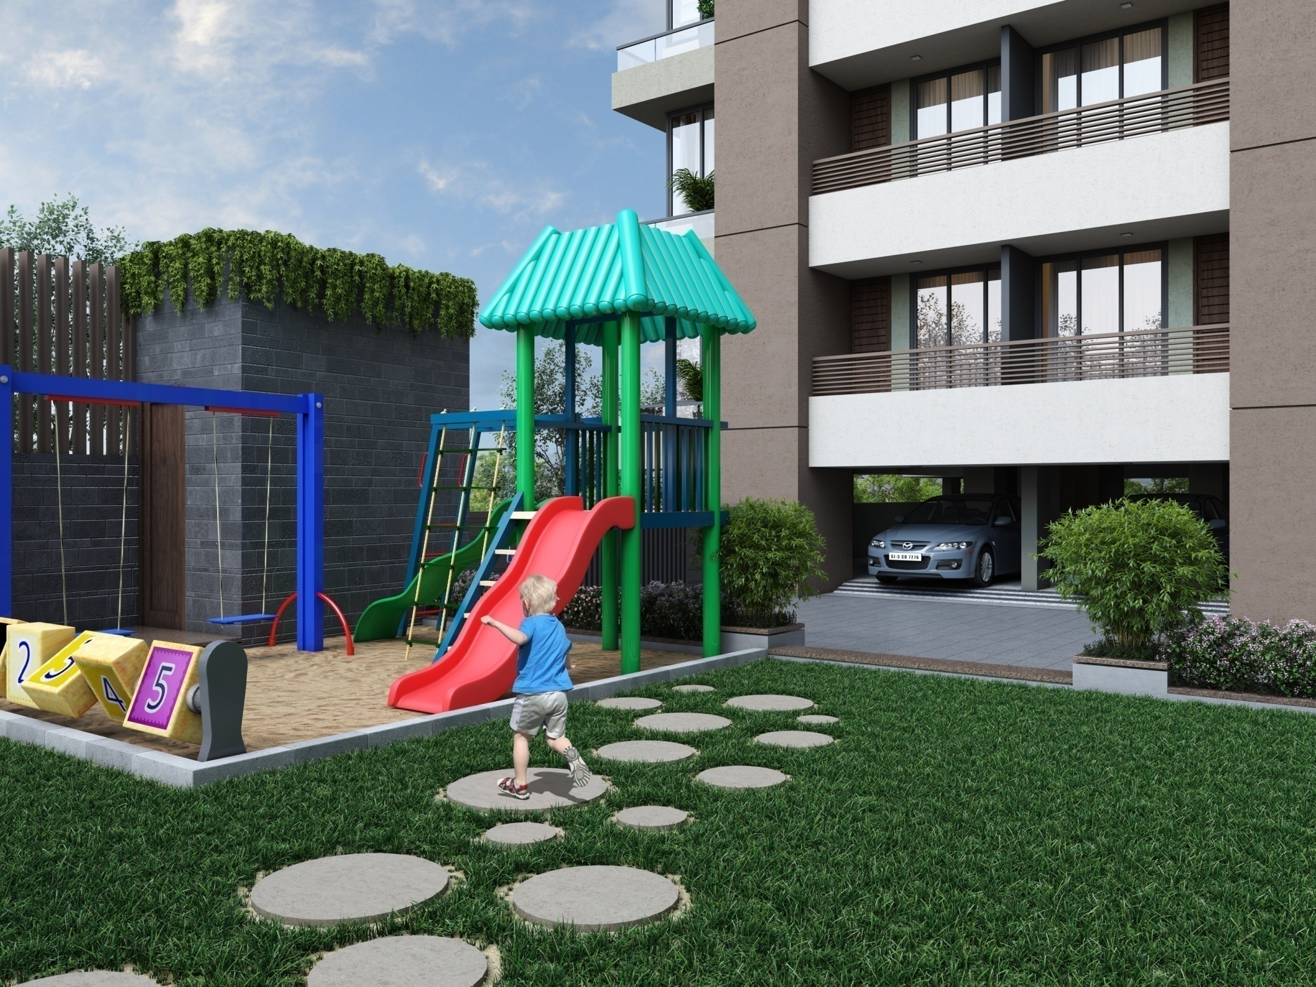

Slide 36
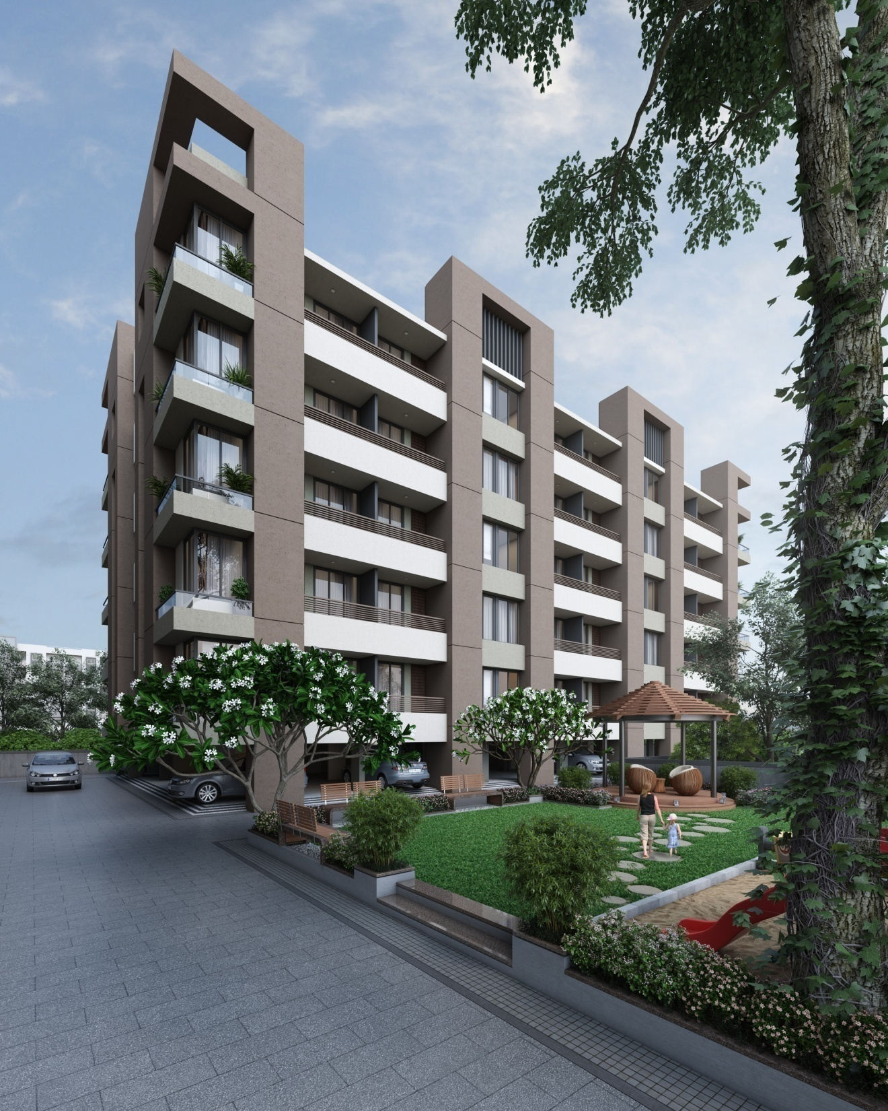

Slide 37
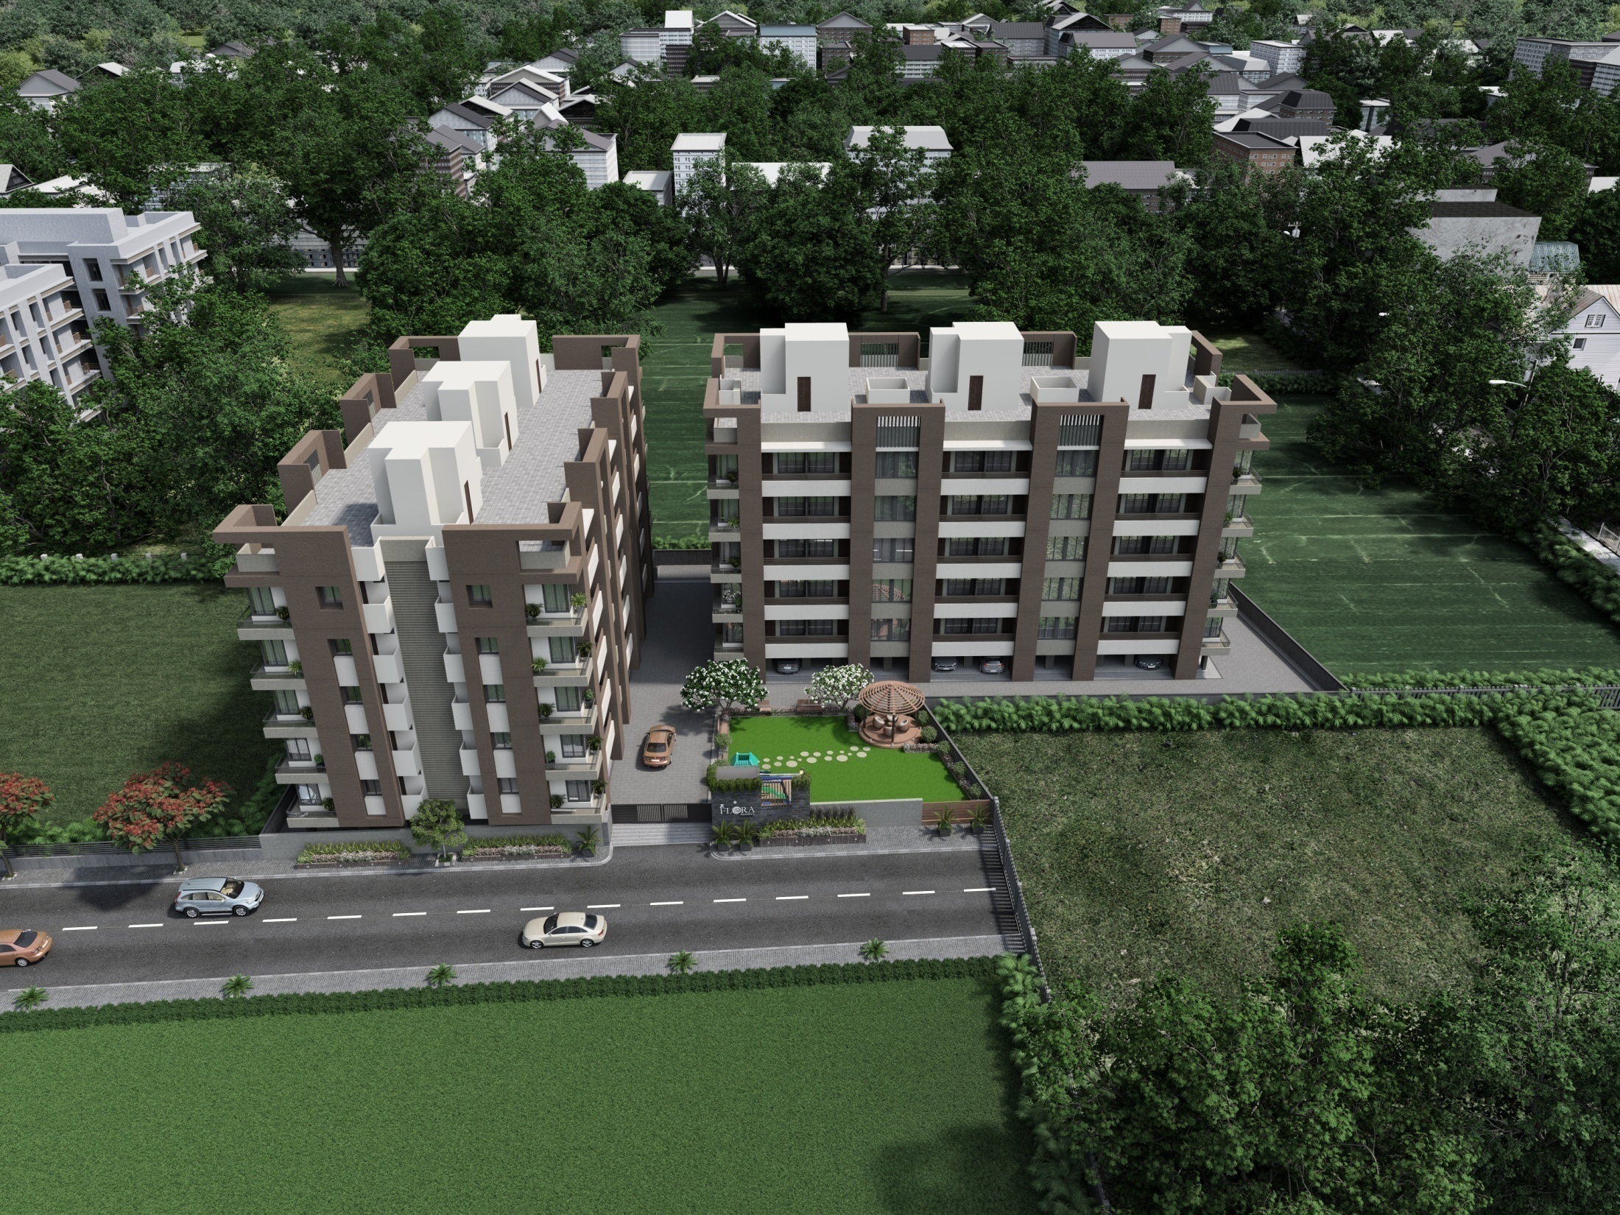

Slide 38
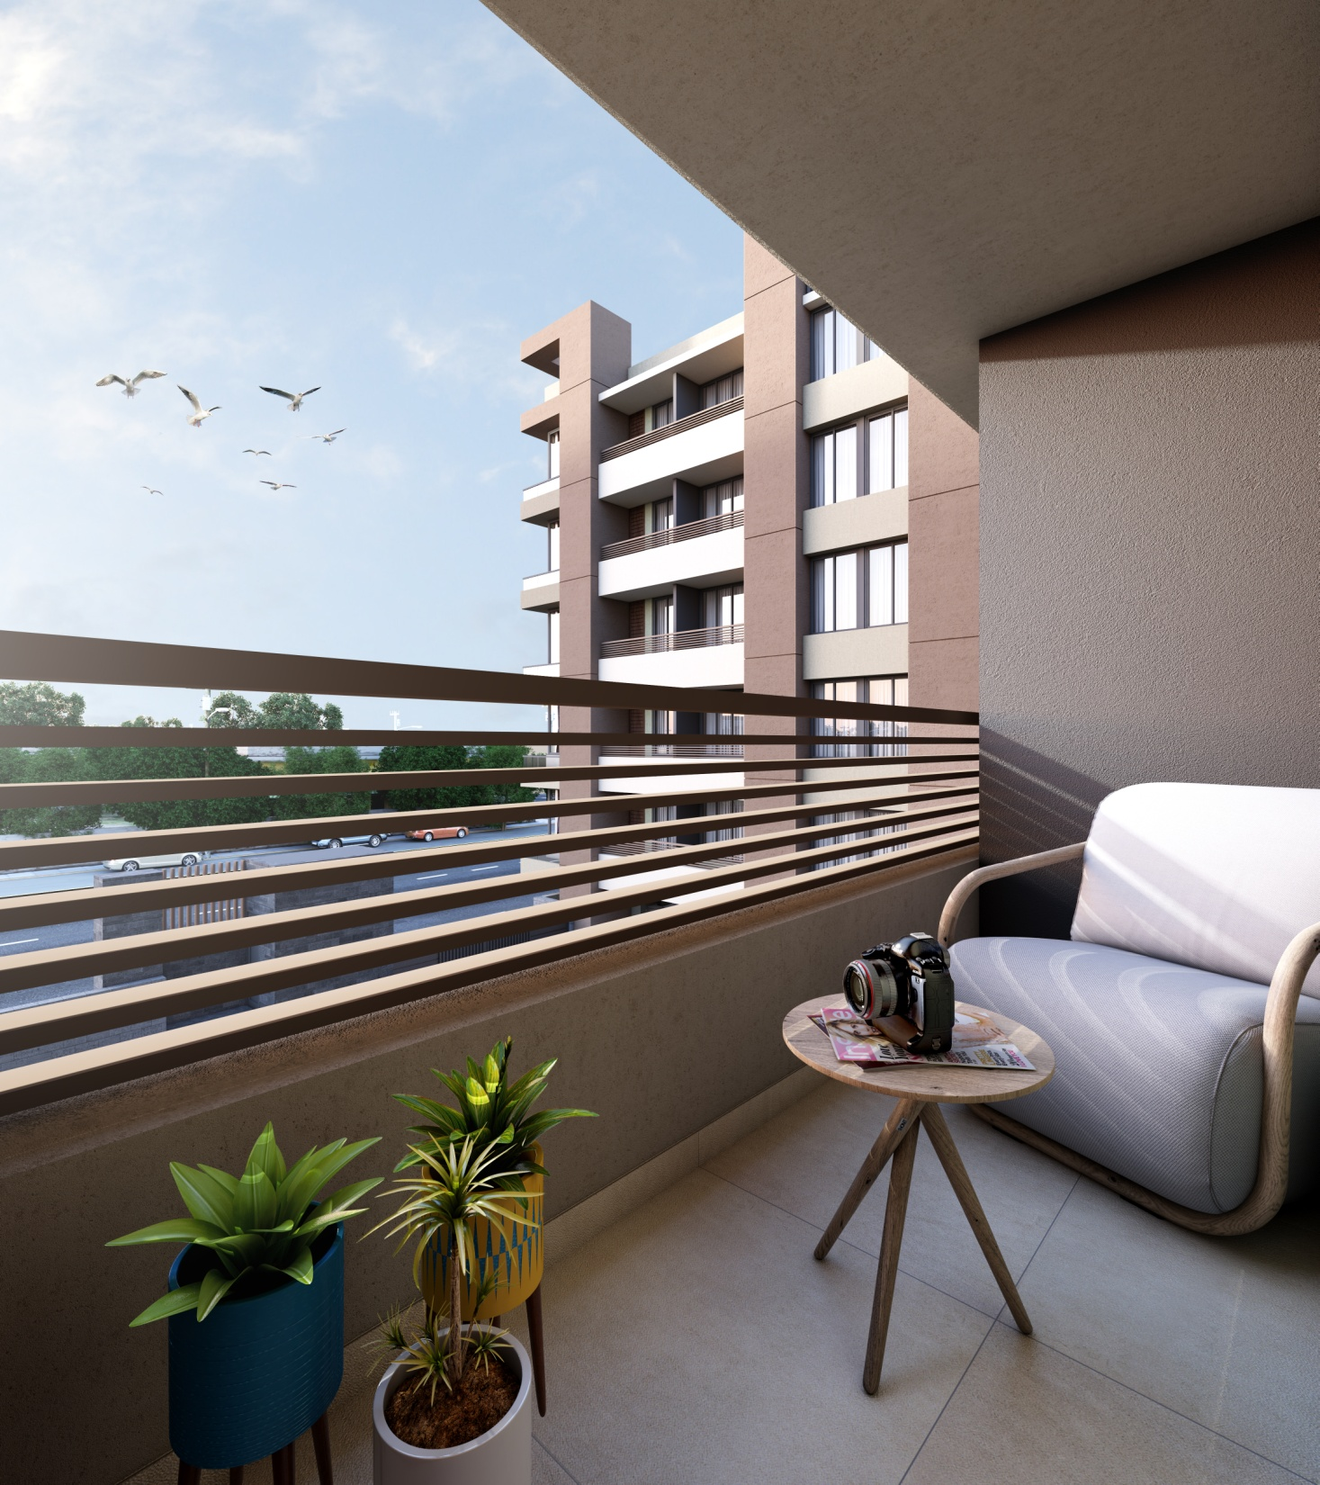

Slide 39
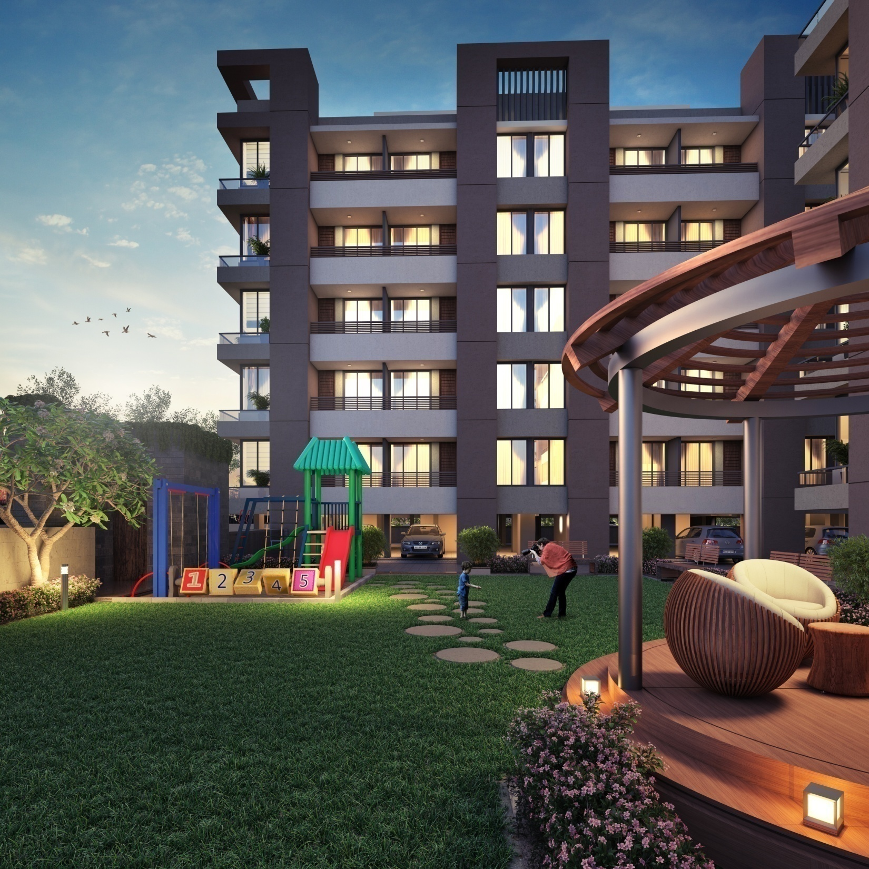

Slide 40
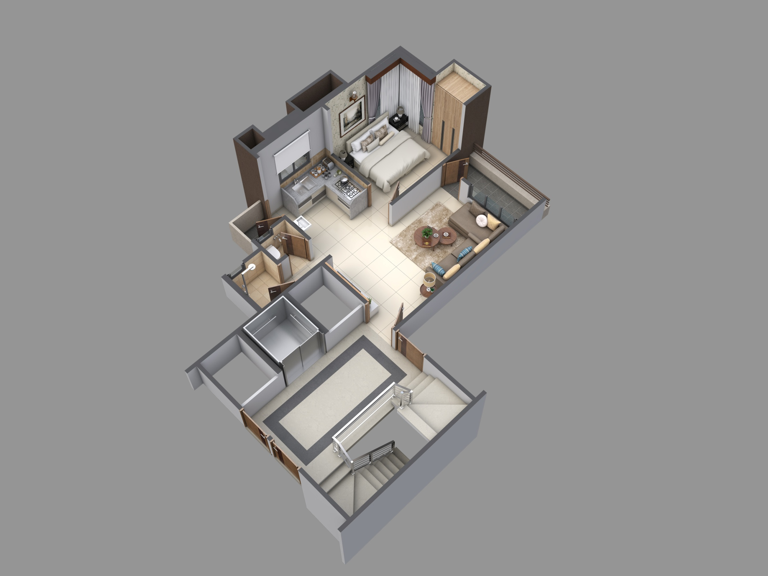

Slide 41
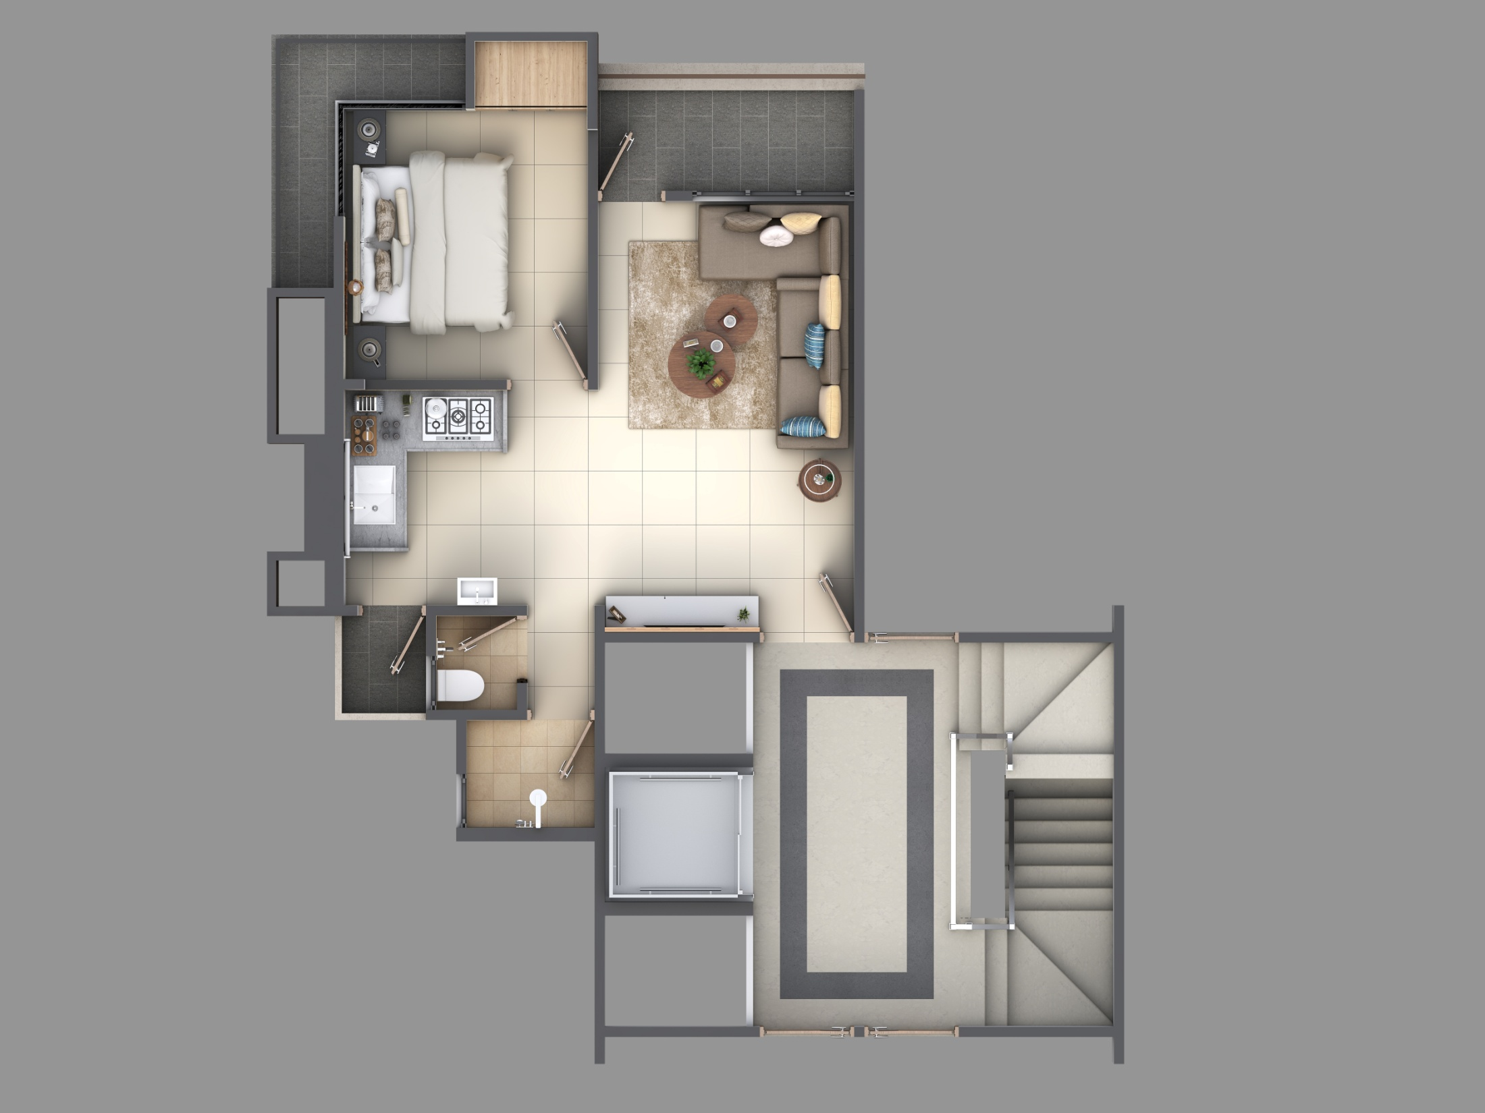

Slide 42
OUR
ON-GOING
PROJECTS

Slide 43
7X RIVERA
ZADESHWAR TAVRA ROAD
BHARUCH
SHOPS,2BHK & 3BHK FLATS
LUXURY BEYOND STYLE

Slide 44
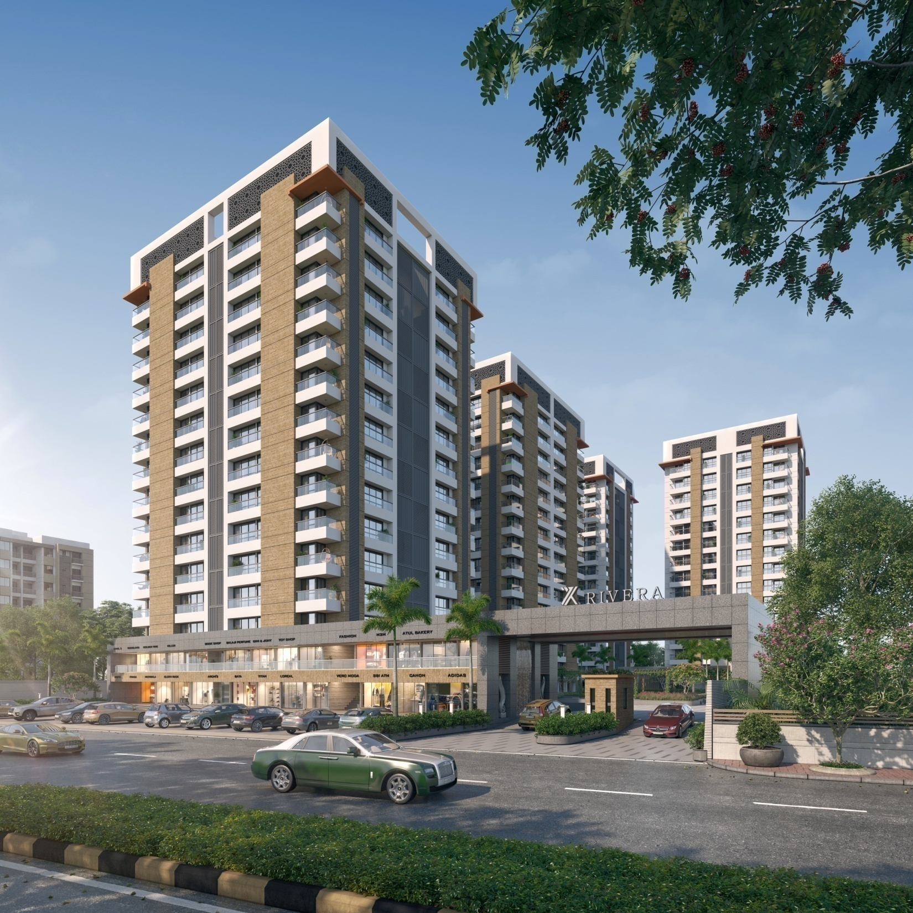

Slide 45
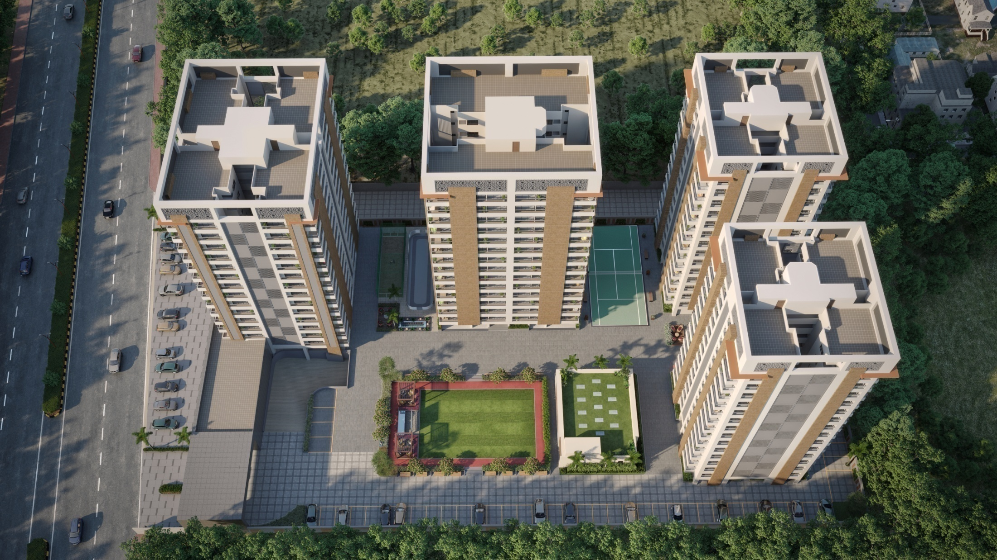

Slide 46
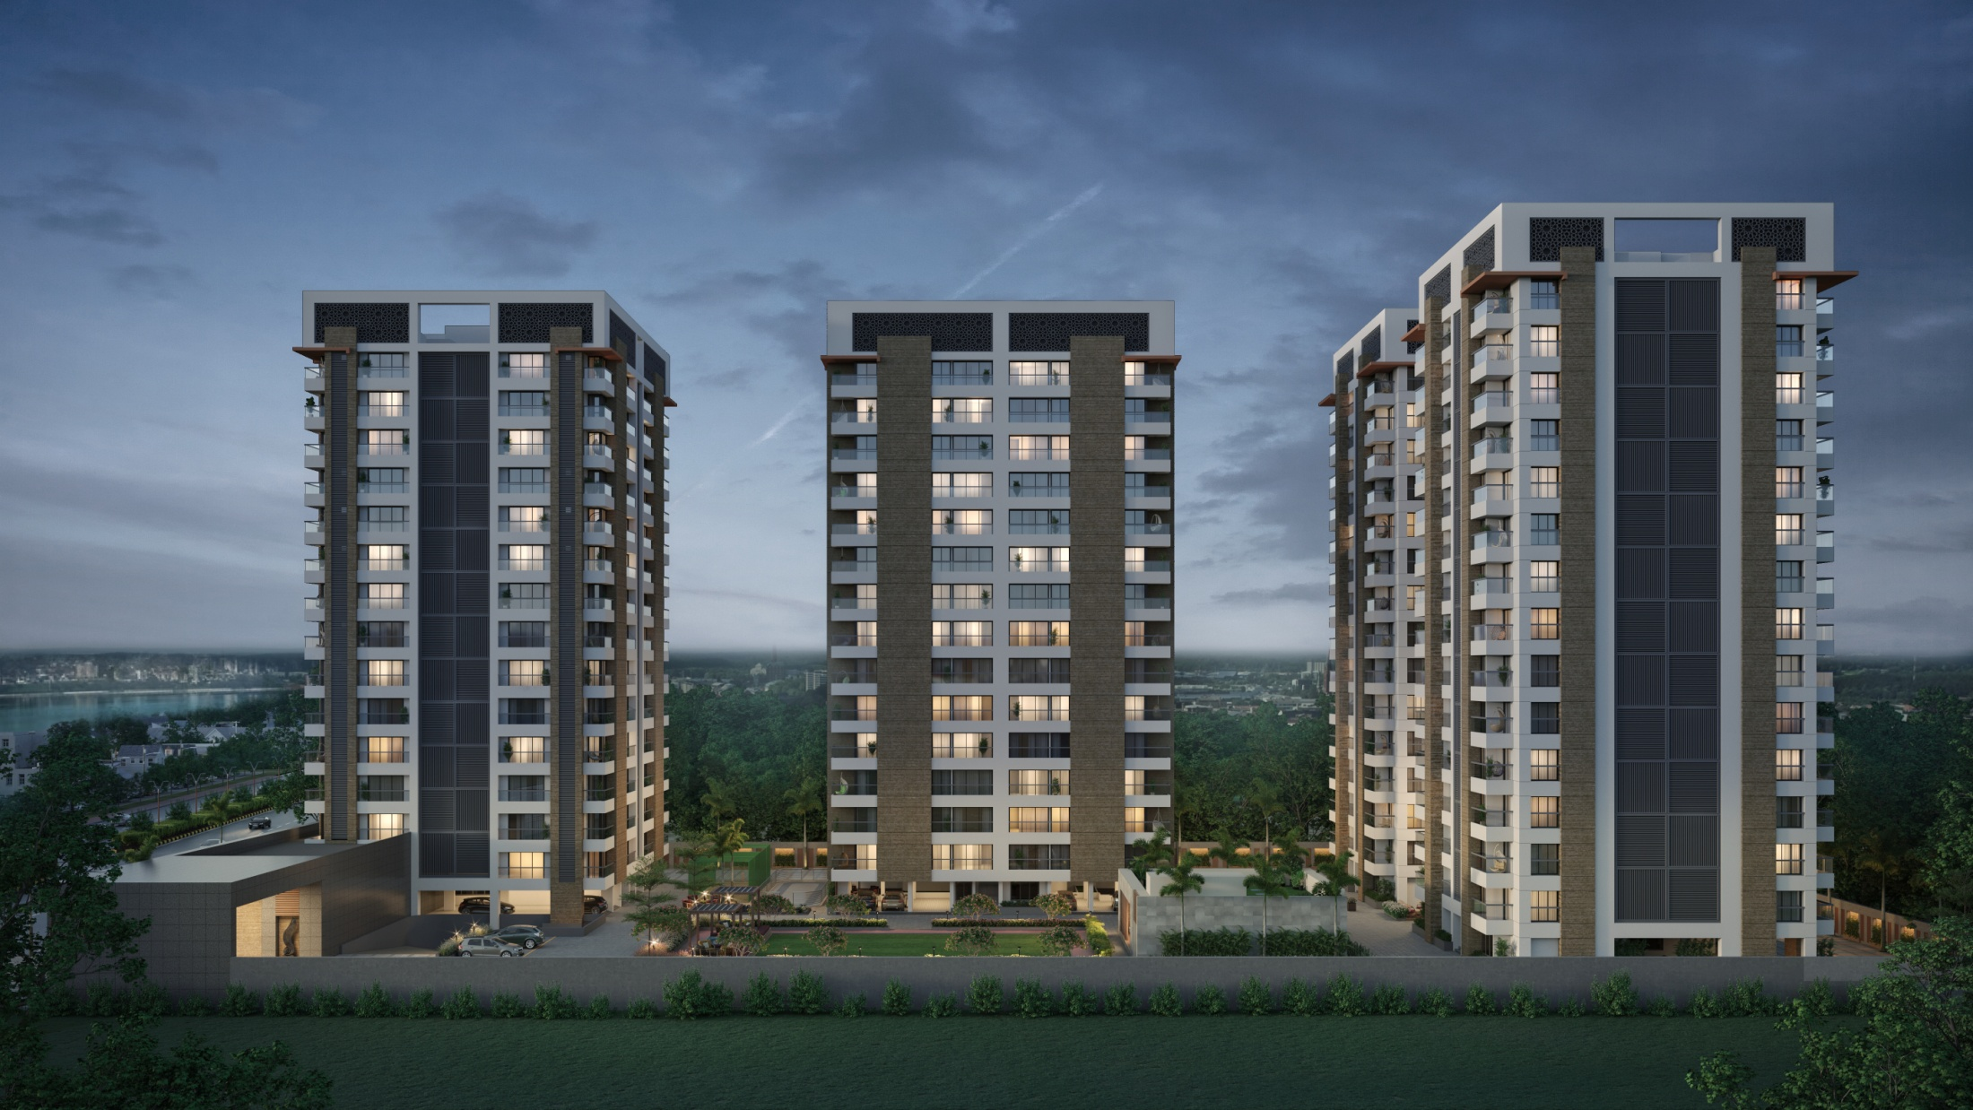

Slide 47
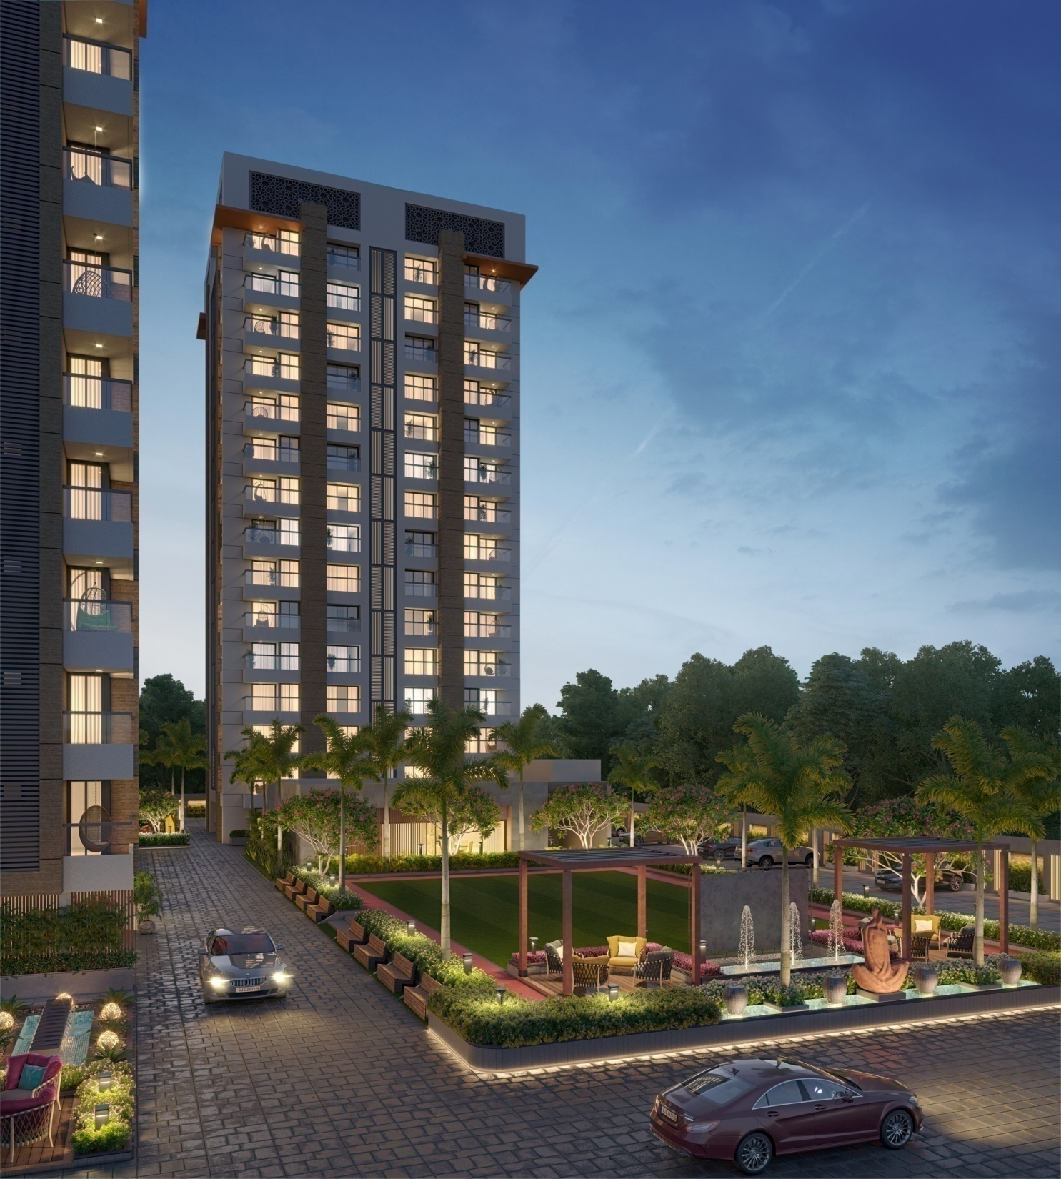

Slide 48
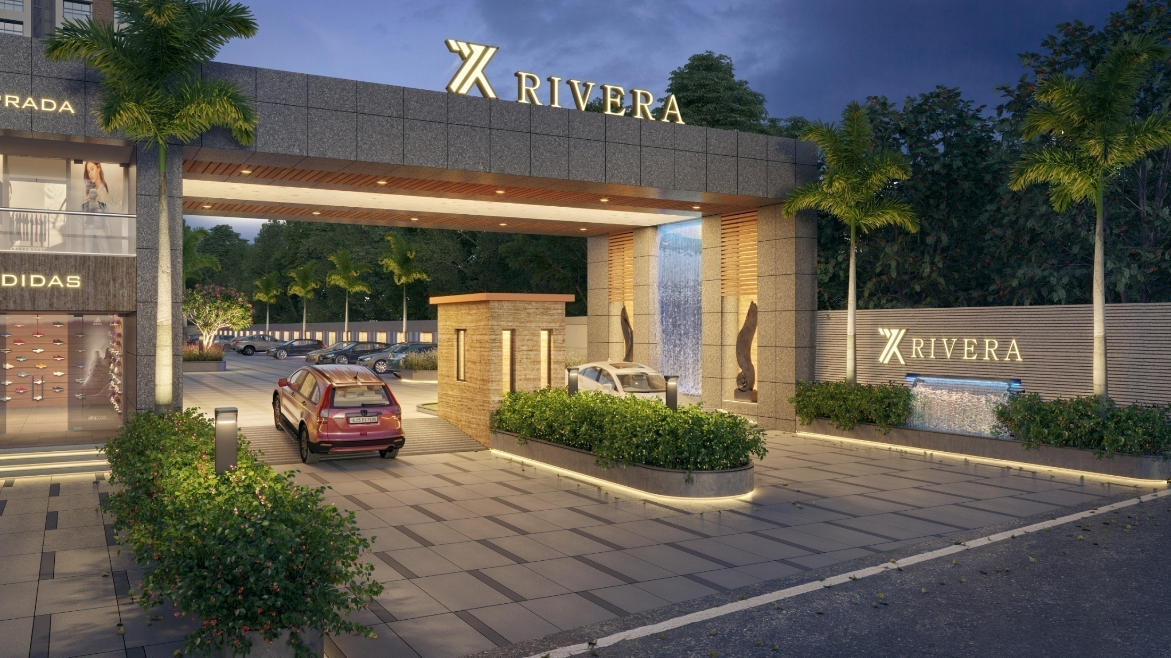

Slide 49
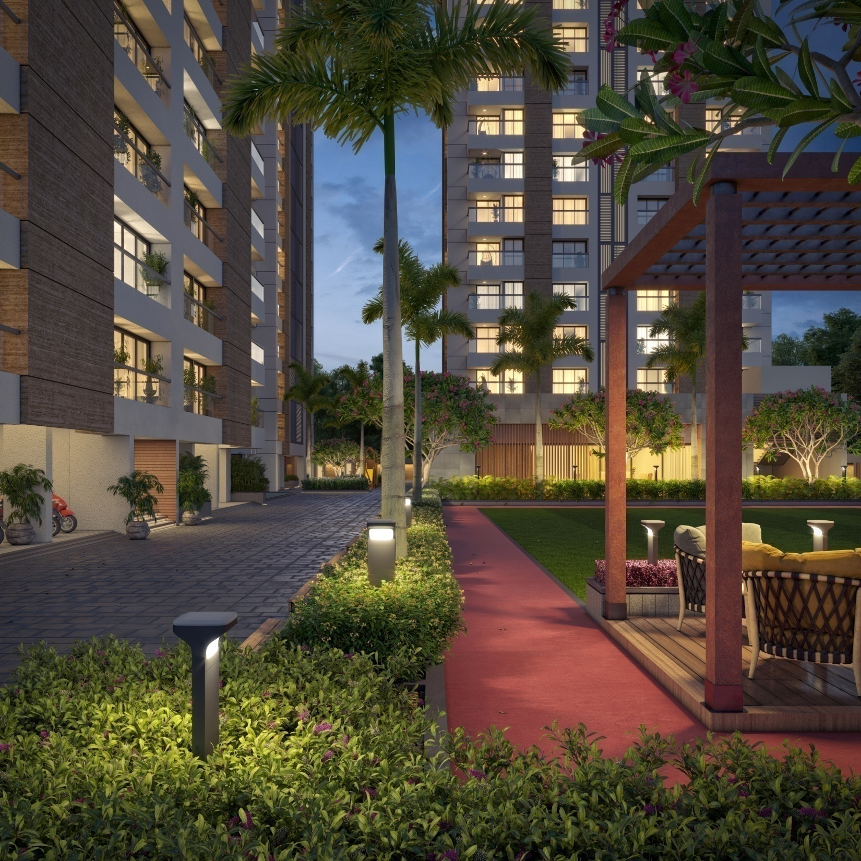

Slide 50
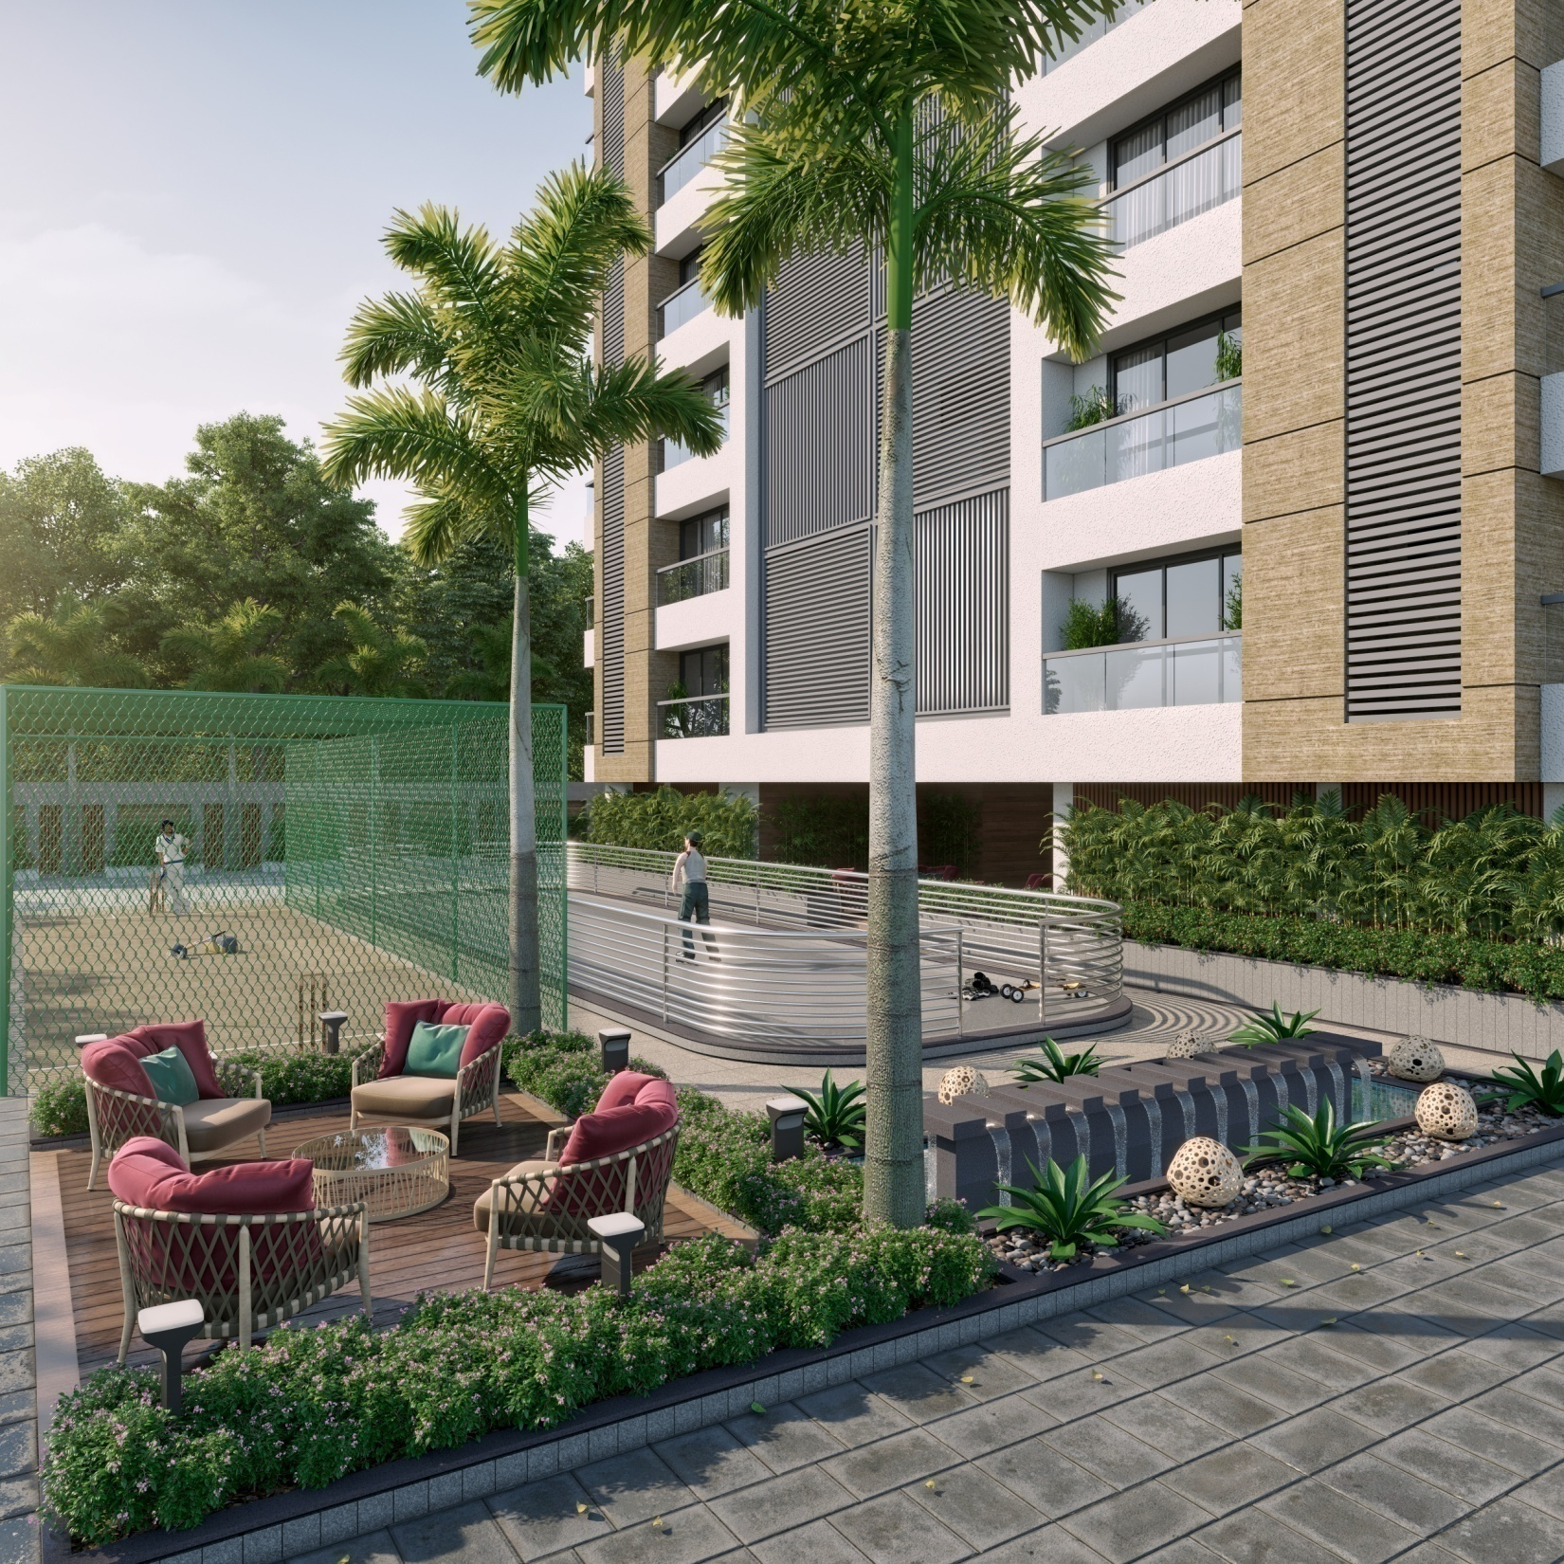

Slide 51
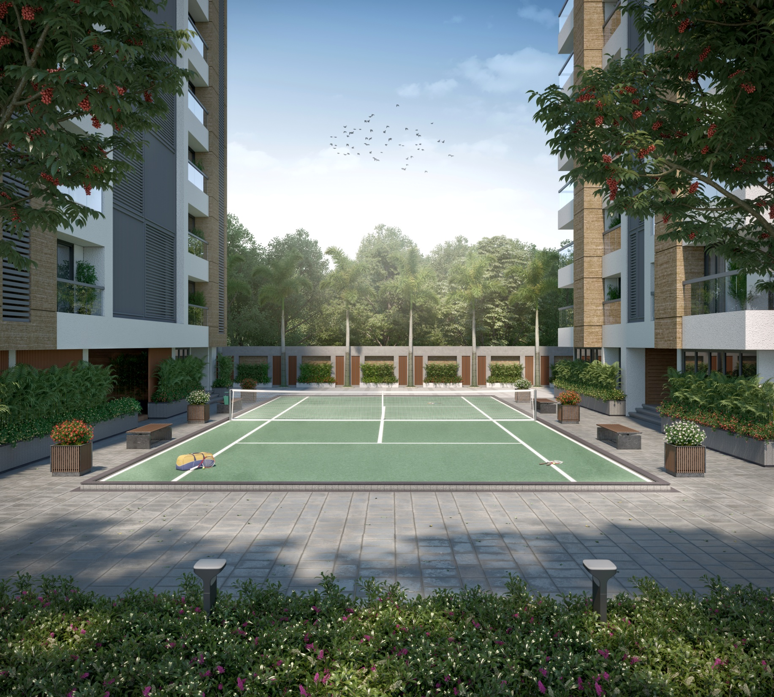

Slide 52
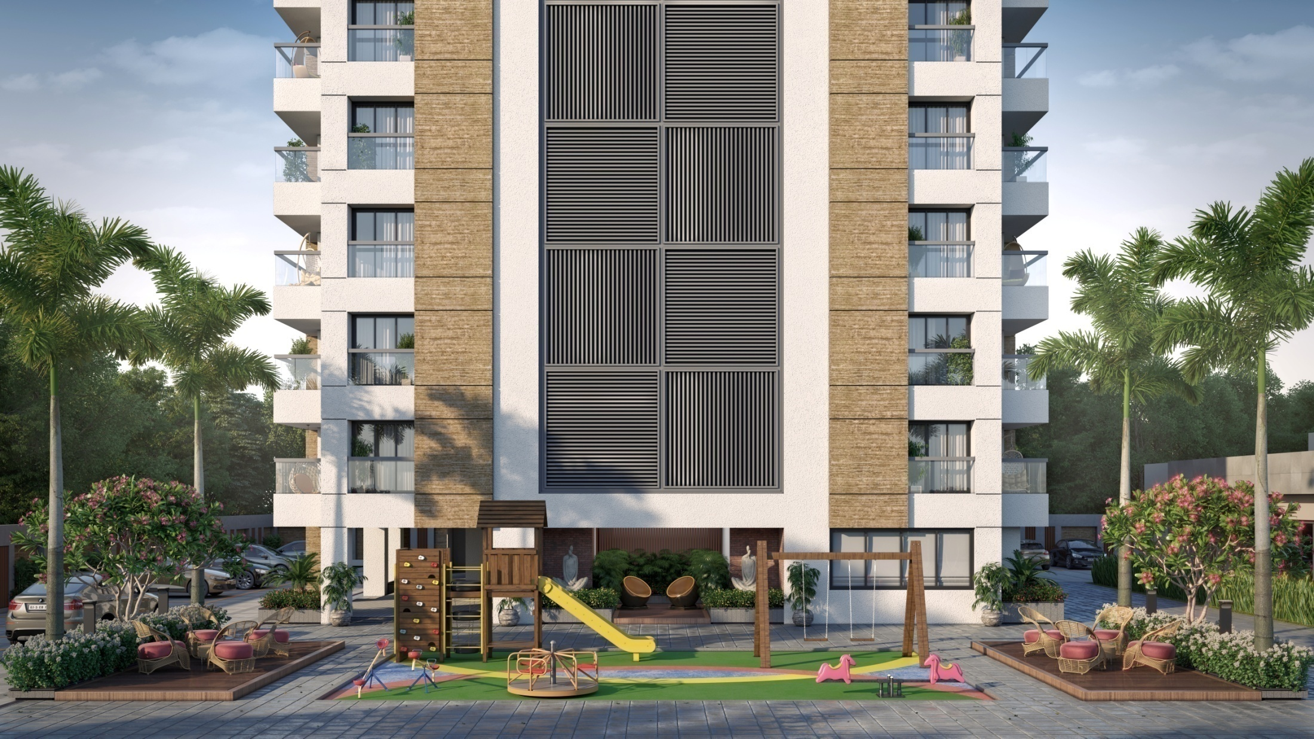

Slide 53
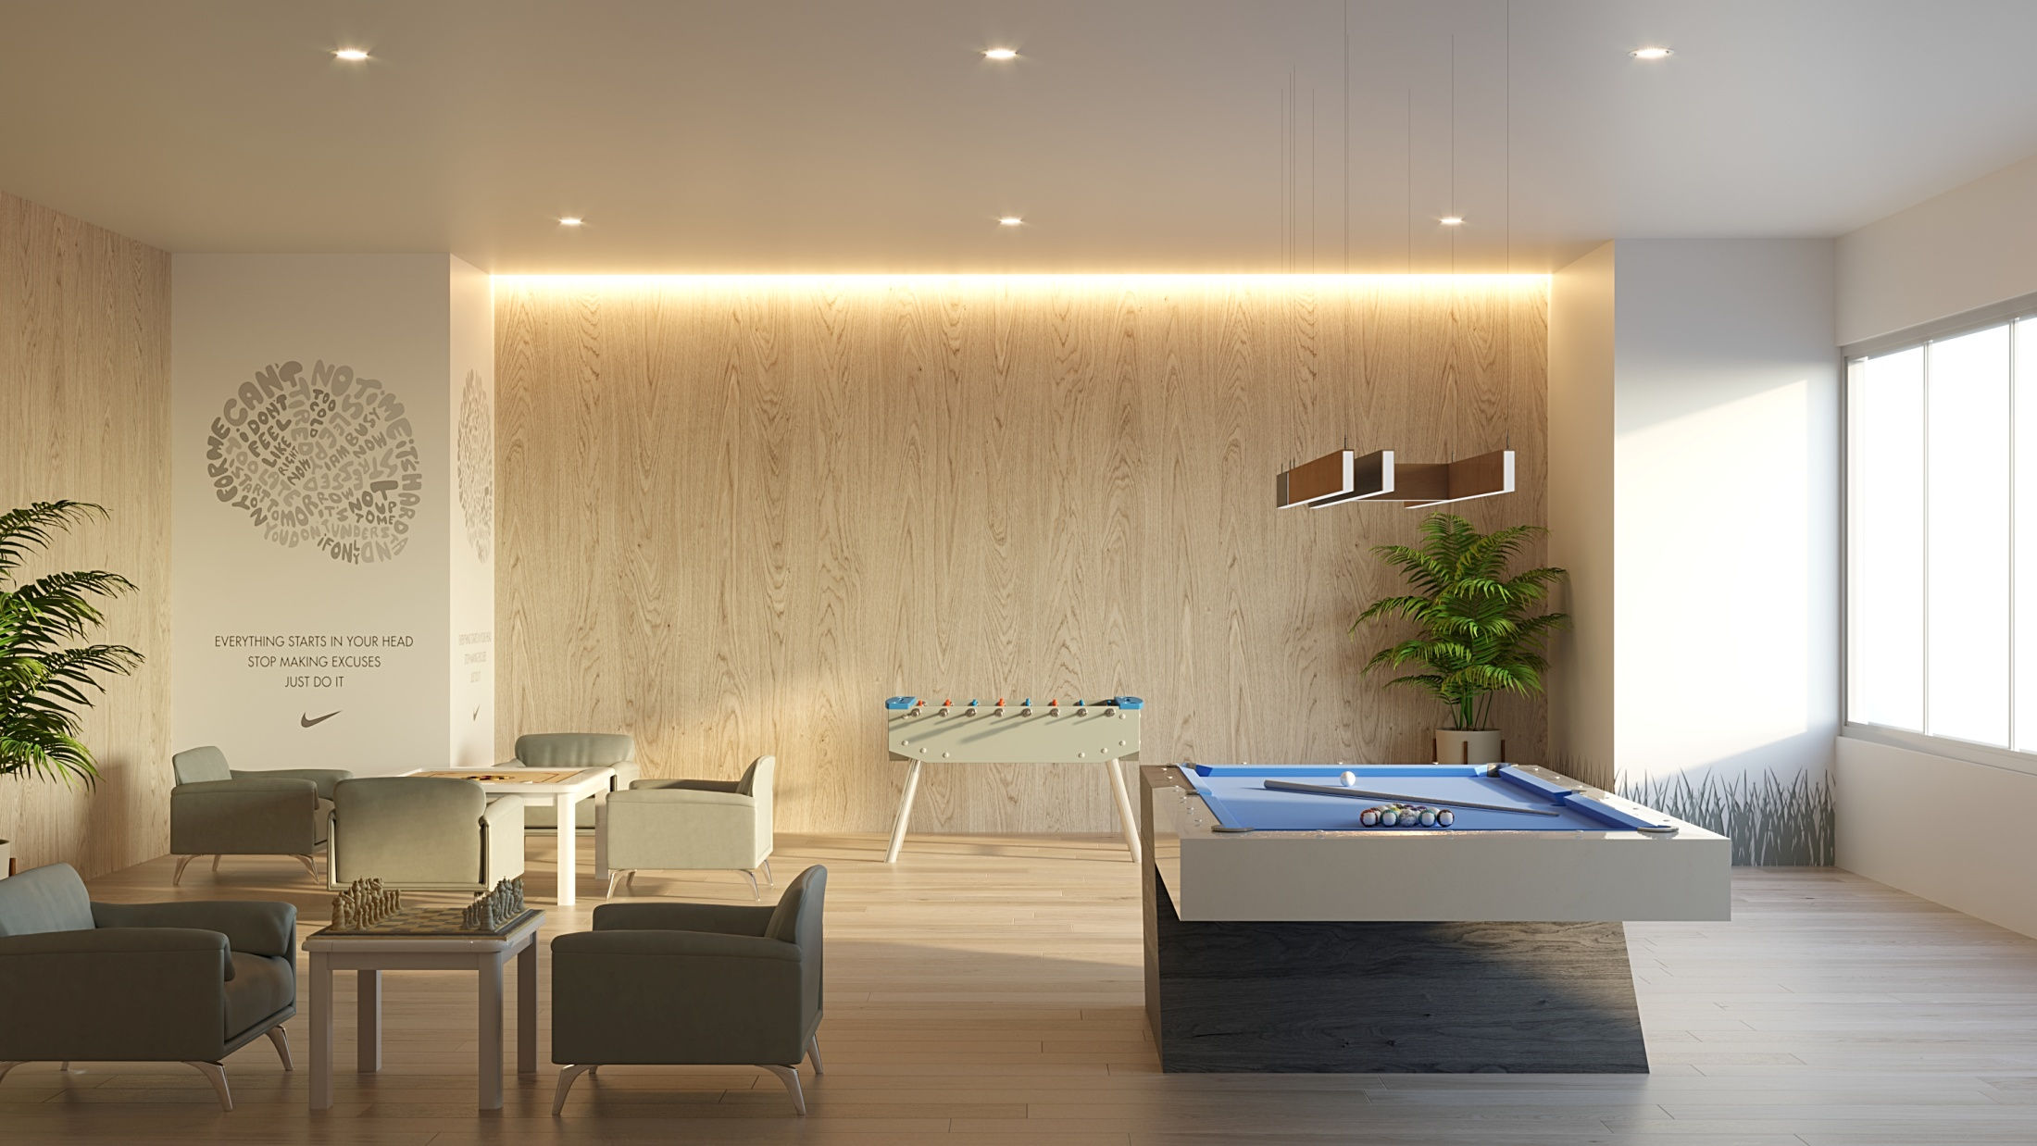

Slide 54
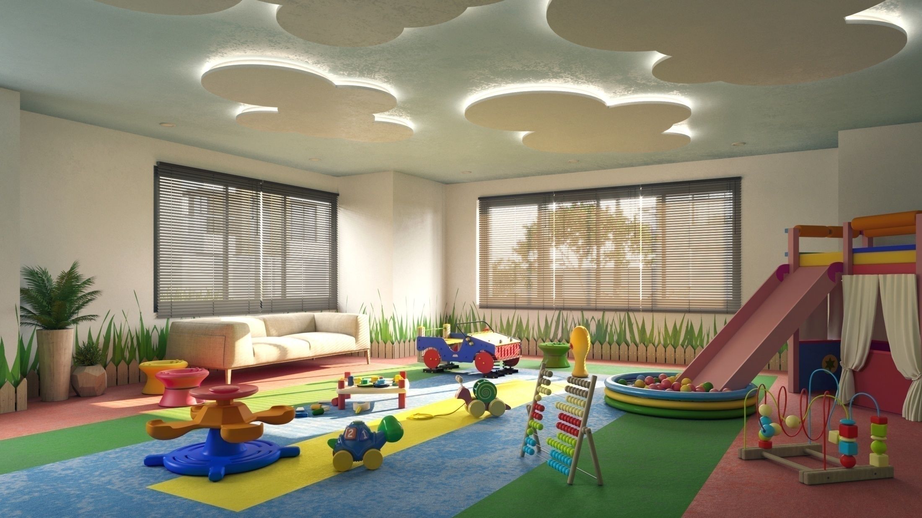

Slide 55
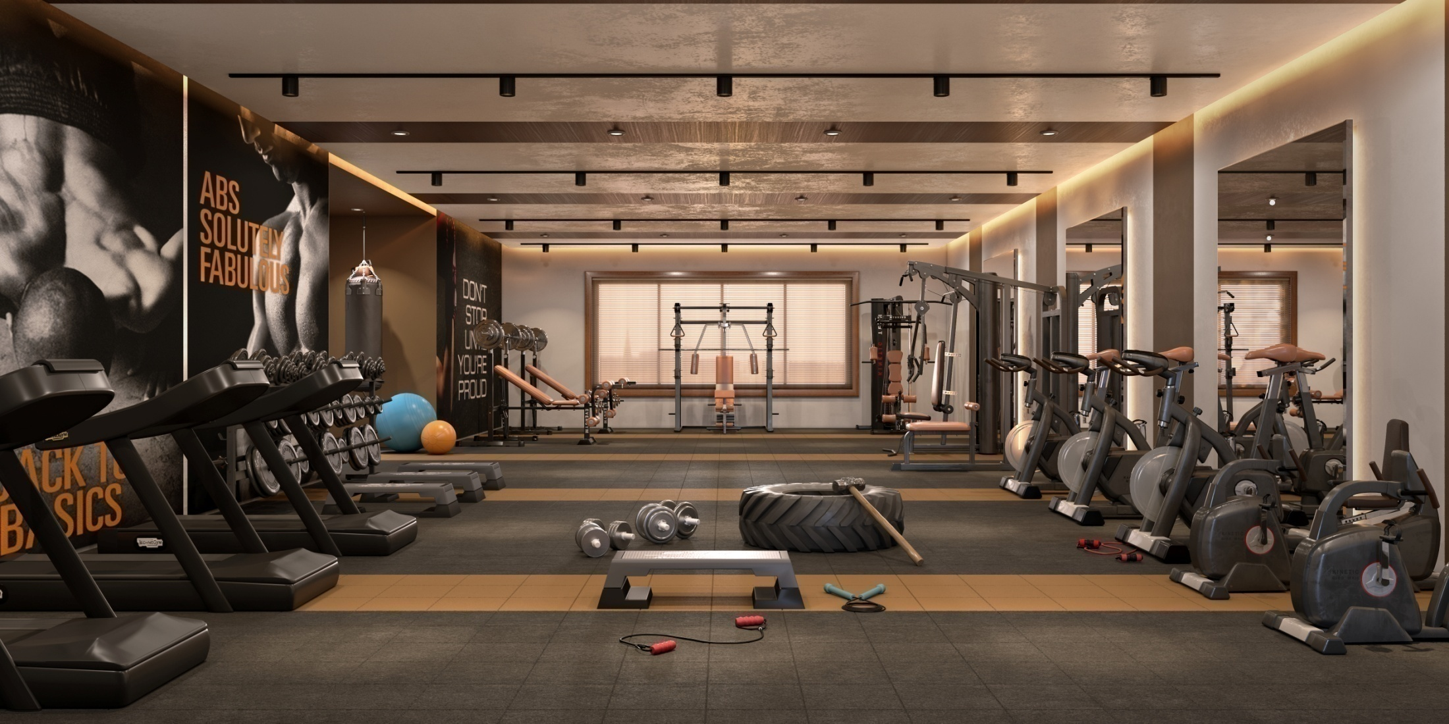

Slide 56
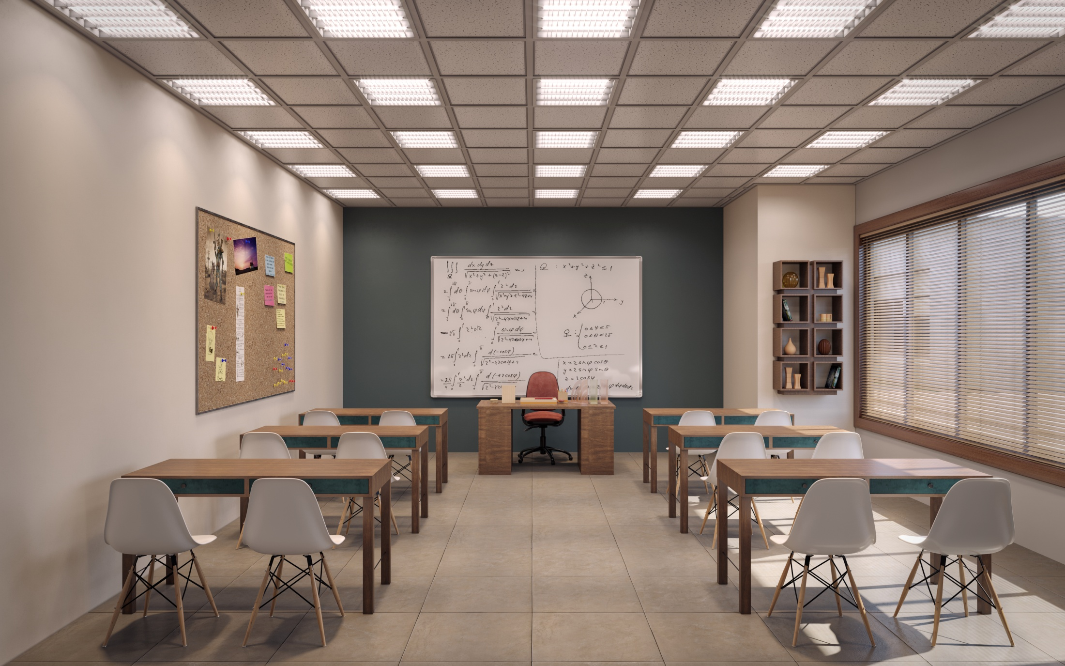

Slide 57
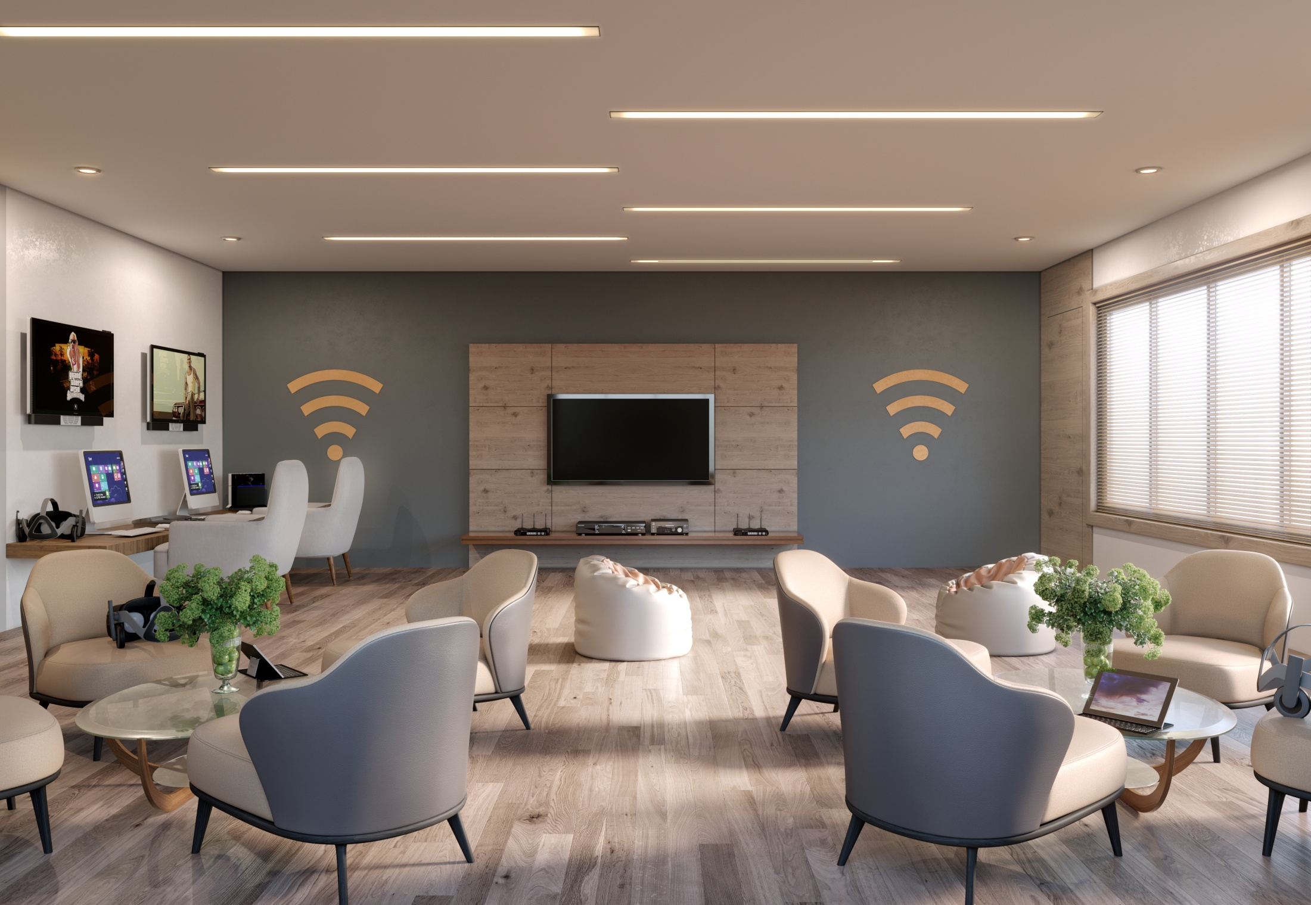

Slide 58
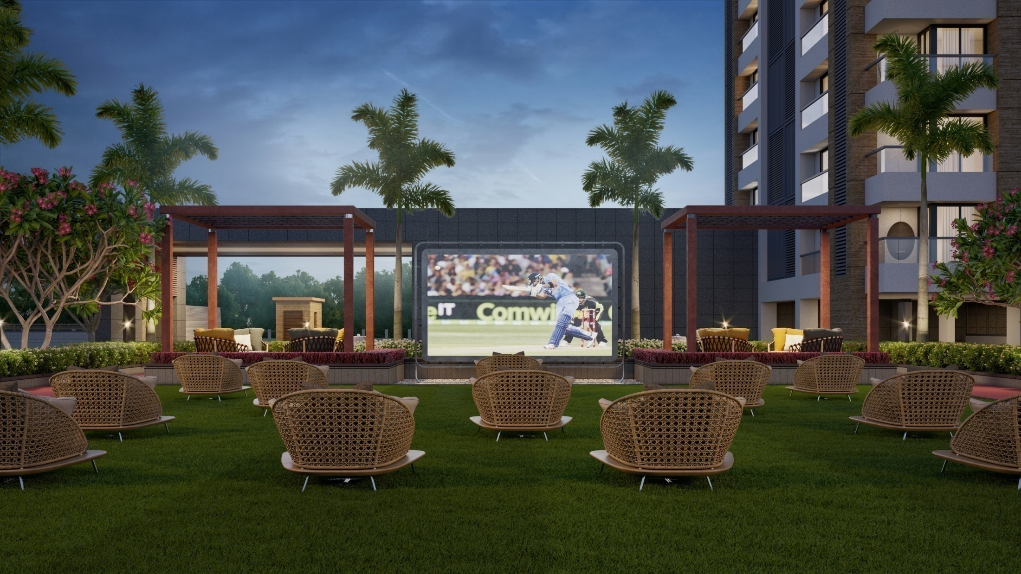

Slide 59
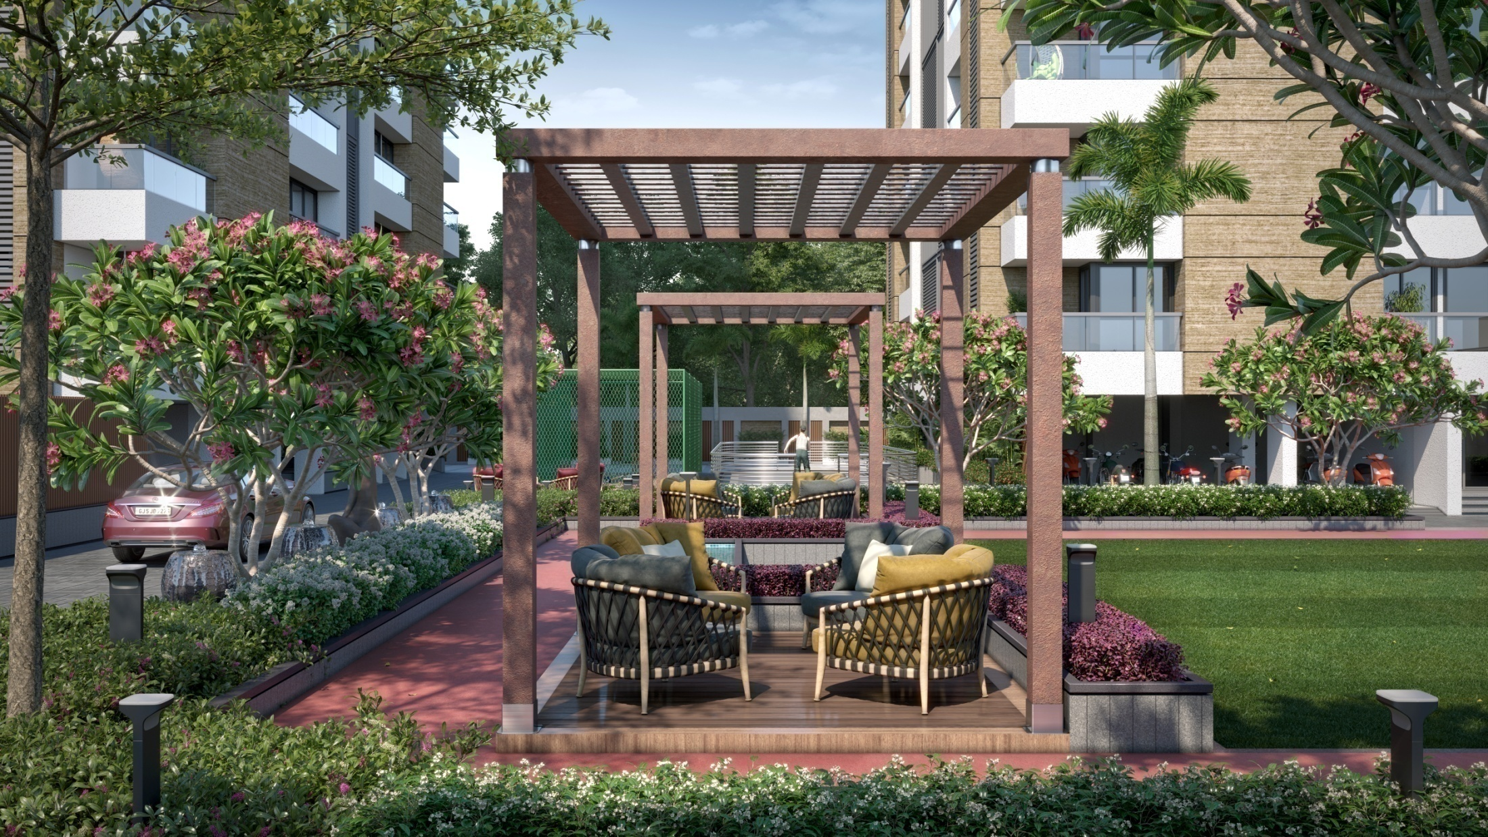

Slide 60


Slide 61


Slide 62


Slide 63


Slide 64


Slide 65


Slide 66


Slide 67


Slide 68


Slide 69


Slide 70


Slide 71
THANK-YOU
Visit: www.7xgroup.in
For more information

